Slide 1
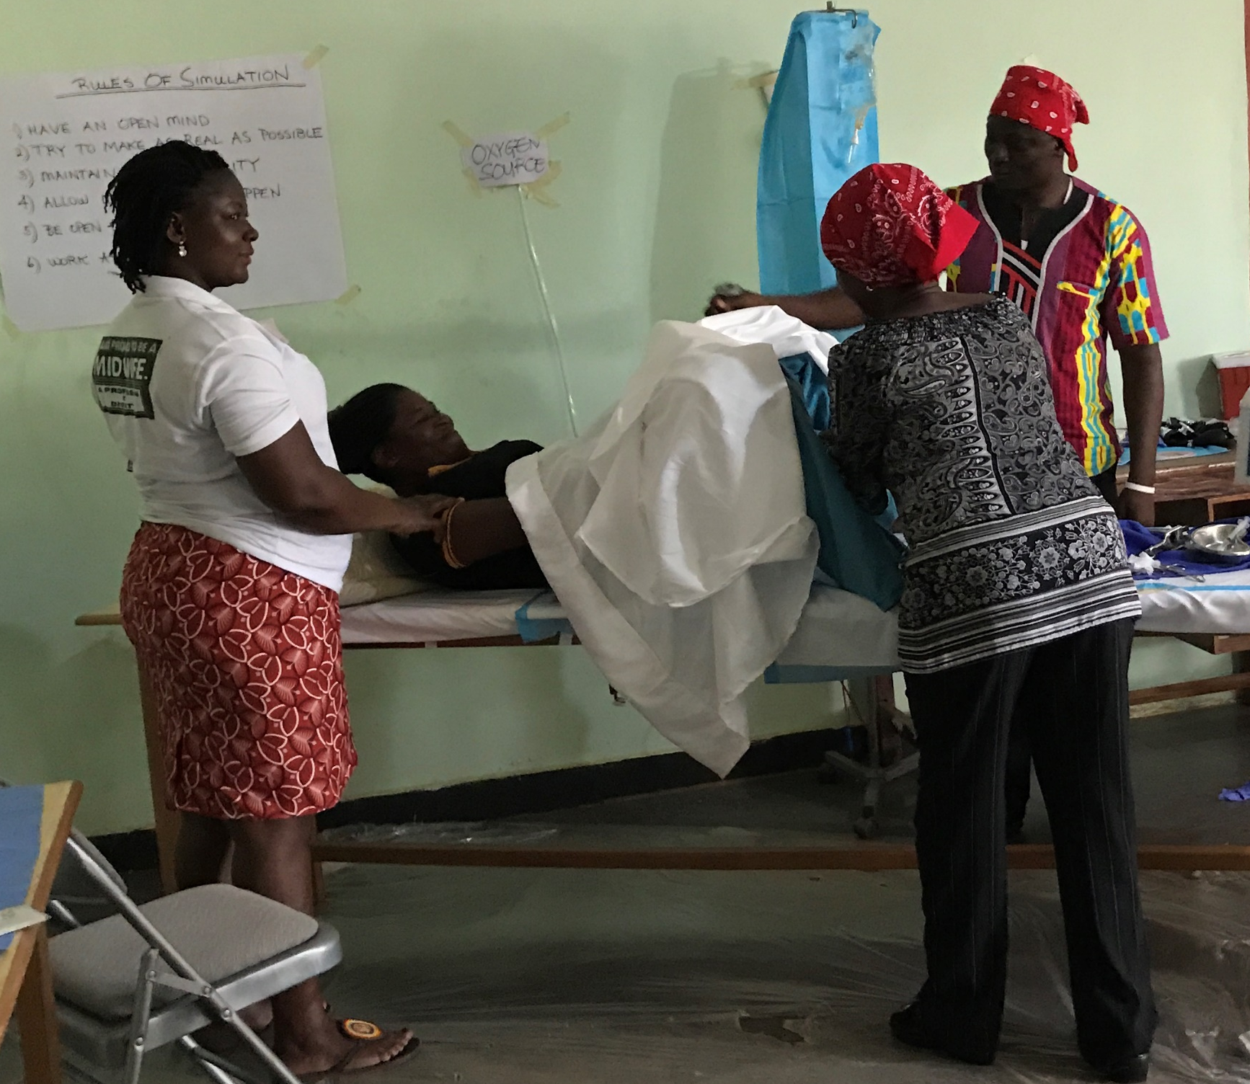

The Caring for Providers to Improve Patient experience (CPIPE) study
Dr. Linnet Ongeri
Kenya Medical Research Institute
Notes:
https://globalhealthsciences.ucsf.edu/event/ighs-grand-rounds-patience-afulani-mbchb-mph-phd
https://obgyn.onlinelibrary.wiley.com/toc/18793479/2023/163/S1

Slide 2
Study Background and Rationale
Widespread issue
Disrespect and abuse normalized
Provider Burden
Stress & Burnout undermine care
CPIPE Solution
Integrated strategy for provider wellbeing + PCMC

Slide 3





Investigator team
Partner Institutions
Name and Qualifications | Role | Institutional Affiliation
Patience Afulani, MBChB, MPH, PhD | Principal Investigator | UCSF
Linnet Ongeri, MBChB, MMed, PhD | Site Principal Investigator- Kenya | KEMRI
Raymond Aborigo, PhD | Site Principal Investigator- Ghana | NHRC
Jerry John Nutor RN, PhD | Co-Investigator | UCSF
Dilys Walker MD | Co-Investigator, Simulation Training Expert | UCSF
Joyceline Kinyua, MPH | Co-Investigator | KEMRI
Tor Neilands, PhD | Co-Investigator- Study Statistician | UCSF
Maxwell Dalaba PhD | Co-Investigator-Health Economist | UHAS/NHRC
Wendy Berry Mendes, PhD | Co-Investigator- Psychologist | Yale
Iscar Oluoch, PhD | Co-Investigator- Social Scientist | Independent Consultant
Migori and Homabay County, and Upper East and NorthEast Region Health Directorates
Notes:
Caring for Providers to Improve Patient Experience (CPIPE) study is five-year research project being implemented by a team of researchers from KEMRI and UCSF and Ghana.
Migori County
Dr Iscar Oluoch, PhD, CAB chair
James Odour, MBChB, Deputy CAB chair

Slide 4

CPIPE trial objectives
Aim 1
Assess the effectiveness of the CPIPE intervention on Person-centered maternity care (PCMC)
Aim 2
Examine the mechanisms of impact of CPIPE on PCMC
Aim 3
Assess impact of the CPIPE intervention on distal outcomes impacted by PCMC
Notes:
Assess impact of the CPIPE intervention on distal outcomes including maternal health seeking behavior and health; and if changes in PCMC account for these effects
Poor person-centered maternal care (PCMC) contributes to high maternal mortality and morbidity, directly and indirectly, through lack of, delayed, inadequate, unnecessary, or harmful care. The proposed R01 will test the effectiveness of an intervention that targets provider stress and bias to improve PCMC. We will accomplish this through 3 aims. Aim 1: to assess the effectiveness of the CPIPE intervention on PCMC in Kenya and Ghana. We hypothesize that CPIPE will improve PCMC for all women, and especially for low SES women. Our primary outcome is PCMC measured with the PCMC scale through multiple cross-sectional surveys of mothers who gave birth in the preceding 12 weeks in study facilities at baseline (prior to intervention), midline (6 months post-baseline), and endline (12 months post-baseline) (N=2000 at each time point). A sub-aim 1 will assess the cost-effectiveness of CPIPE. Aim 2: to examine the mechanisms of impact of CPIPE on PCMC. We will assess the effect of CPIPE on intermediate outcomes such as provider knowledge, self-efficacy, stress, burnout, and bias levels; and conduct mediation analysis to assess if changes in these outcomes account for the effect of CPIPE on PCMC. Aim 3: to assess impact of the CPIPE intervention on distal outcomes including maternal health seeking behavior and maternal and neonatal health; and examine if changes in PCMC account for these effects.

Slide 5
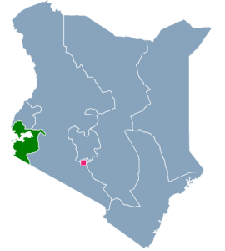
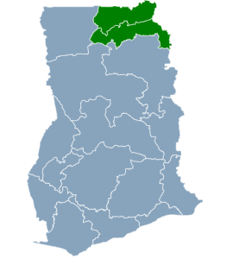
Setting:
Western Kenya: Migori and Homabay Counties
Northern Ghana: Upper East and North East regions
Study Regions in Kenya
Study Regions in Ghana
Notes:
The study will be conducted in Migori County, which is a rural coumty in Western Kenya and one of the counties with the highest maternal mortality in Kenya

Slide 6
Study Participants
Provider cohort:
400 Healthcare workers who provide MCH services; at least 6 months of experience
N=200 in each country; followed longitudinally with data collection at 3 time points over 12 months
Women:
6000 women who have given birth in prior 2 weeks in the study facilities,
N=1000 in each country at each timepoint; multiple cross-section at baseline, midline, and endline
Receive intervention
No intervention but primary beneficiaries
Notes:
Healthcare workers (including nurses, midwifes, doctors, clinical/medical officers, and support staff) who provide MCH services (including antenatal, intrapartum, and postnatal care); at least 6 months of experience
N=5-15 providers per facility, for a total of up to N=200 providers in each country; followed longitudinally with data collection at 3 time points
50 providers per facilty

Slide 7
Study Design
Cluster randomized-controlled trial in 40 high-volume delivery health facilities in Kenya and Ghana (20 in each country)
40 study facilities
20 intervention facilities
Baseline
20 control facilities
Baseline
Intervention
midline
midline
endline
endline
intervention
6 months
6 months
Notes:
Randomization at facility or sub-county level
Intervention arm will receive intervention after baseline
Control arm will receive intervention after endline

Slide 8
Primary outcome
Person-centered maternity care (PCMC)
PCMC scale
Dignity and Respect
Communication and Autonomy
Supportive Care
Responsive, Compassionate, and Respectful care
Notes:
Reomve alpha

Slide 9
Intermediate outcomes
Stress knowledge
A 10-question knowledge of stress and stress management assessment adapted from existing questions.
Implicit bias knowledge
A 10-question assessment of unconscious bias adapted from existing questions
Perceived Stress
The 10-item Cohen Perceived Stress Scale (PSS) on people’s feelings and thoughts in the past month.
Burnout
The 14-item Shirom-Melamed Burnout Measure (SMBM) on feelings at work in the past month.
PCMC
The 9-item provider reported PCMC measures care provision in the last month.
Explicit bias
Two situationally specific vignettes assessing providers’ perceptions of women’s PCMC expectations and behaviors based on SES.
Implicit bias
Implicit bias awareness and mitigation scale
Notes:
Age, gender, marital status, parity, education, perceived social status, Position, experience…and prior training on stress management, bias, and patient-provider interactions.

Slide 10
Distal outcomes
Postpartum health seeking behavior
Postnatal care timing, breast feeding
Postpartum mental health
Postnatal depression
Facility outcomes
facility service utilization and morbidity and mortality data
Newborn health
Vaccinations, illness

Slide 12
Mental health-focused training content
Understanding stress and burnout
Physiology of acute stress
Chronic stress and burnout symptoms
Stress management techniques
Mindfulness
Social support
Diet, sleep,physical activity
Cognitive restructuring
Seeking professional help
Simulation
Complex cases integrated with stress management

Slide 13
Description of study population Kenya and Ghana, N = 414
Characteristics | Finding
Age (Mean, SD) | 36 years
Gender | Females 83%
Marital Status | Married 86%
Monthly salary | 63% Ksh 10,000-50,000
Facility type | Gov’t Hospital: 68.8% ・ Gov’t HC: 20.0% ・ Mission/Private Hosp: 11.1%
Position | Midwife: 48.6% ・ Nurse: 32.4% ・ Others: 19.0%
Workload | Hours/day: >8 hrs/day: 26.1% Days/week: >5 days: 20.3%
Sleep Quality | Poor 8.9% Fair 32.9% Good 58.2%
Job Satisfaction | Satisfied: 78.0% ・ Dissatisfied/Neutral: 22.0%

Slide 14
Stress, burnout and depression scores.
Table 2. Summary of outcome measures among providers in Kenya and Ghana
Outcome measures | Overall (N=414) | Kenya (N=200) | Ghana (N=214) | p
Perceived stress score, mean (SD) | 17.72 (4.56) | 18.42 (5.15) | 17.05 (3.83) | 0.002
Perceived stress score categorized
Low stress '0-13.9' | 68 (16.4) | 30 (15.0) | 38 (17.8) | 0.067
Moderate stress '14.0-26.9' | 338 (81.6) | 163 (81.5) | 175 (81.8)
High stress '27.0 or more' | 8 (1.9) | 7 (3.5) | 1 (0.5)
Burnout score, mean (SD) | 2.67 (0.97) | 2.86 (0.98) | 2.48 (0.93) | <0.001
Burnout score categorized
No burnout (≤2.0) | 123 (29.7) | 42 (21.0) | 81 (37.9) | <0.001
Low burnout (2.1 to 3.75) | 222 (53.6) | 115 (57.5) | 107 (50.0)
High burnout (≥3.75) | 69 (16.7) | 43 (21.5) | 26 (12.1)
Depression measure, mean (SD) | 1.03 (1.40) | 1.20 (1.51) | 0.88 (1.27) | 0.023
Depression measure (PHQ2)
No depression (< 3) | 351 (84.8) | 163 (81.5) | 188 (87.9) | 0.072
Probable depression (≥3) | 63 (15.2) | 37 (18.5) | 26 (12.1)

Slide 15
Factors associated with perceived stress among health facility providers in both Kenya and Ghana combined
Country: Participants in Ghana scored significantly lower than those in Kenya (β ≈ -1.3, p<0.001).
Marital status: Being single was associated with higher scores compared to married/cohabiting (β = 1.26, p=0.016).
Workload & job context: More hours worked per day and higher effort–reward imbalance were linked to worse outcomes (both p<0.05).
Health factors: Poor sleep quality and presence of chronic conditions were strongly associated with higher scores (all p<0.01).
Protective factors: Job satisfaction and more frequent exercise showed trends toward better outcomes, though effects were weaker after adjustment.

Slide 16
Key Findings (Burnout Associations)
Country differences: Ghanaian providers reported lower burnout than Kenyan providers in crude analysis, though this attenuated after adjustment.
Salary and role: Higher monthly salary (>382 USD) and being a clinical officer/medical assistant were linked to greater burnout.
Facility type: Providers in mission/private hospitals reported significantly less burnout compared to government hospitals.
Job satisfaction: Being satisfied with one’s job was strongly protective against burnout (β = -0.34, p=0.014).
Health and psychosocial factors: Poor sleep quality and higher overcommitment scores were consistently associated with higher burnout (p<0.01).

Slide 17

Thank you!
Questions?
Comments?

