Slide 1
THE UNSEEN TOLL:
THE PREVALENCE AND FACTORS ASSOCIATED WITH DEPRESSION , PTSD AND BURNOUT AMONGST HUMANITARIAN AID WORKERS IN KAKUMA AND DADAAB REFUGEE CAMPS.
17TH ANNUAL KPA CONFERENCE
DR BRENDA OMBANE
04/09/2025

Slide 2
INTRODUCTION
HAWs provide professional services to populations in crisis
Their work has been cited as dangerous, volatile and unpredictable (Sifaki-pistolla et al,2017)
The UN reports that 360 million people are in humanitarian need
Humanitarian workers operating in conflict-prone areas are often unable to prioritize self-care
Negative mental health consequences-compassion fatigue, depression, anxiety, burnout and PTSD. (WHO,2016)

Slide 3
PROBLEM STATEMENT
Kenyan Refugee Act 2021
Kenya’s ability to handle the rising number of refugees is strained
Leads to physical and psychological stressors amongst HAWs
There is a dearth of data on HAWs in Kenya
Objective:
To determine the prevalence and factors associated with Depression, Burnout and PTSD among Humanitarian aid workers providing healthcare services in Dadaab and Kakuma Refugee camps
Notes:
-Promoted local integration where refugees were able to become self reliant,had freedom of movement and were able to participate in economic development.
-about 850.000 refugees in kenya
-heavy workloads,staff shortages, unsafe living conditions, disease outbreaks, restricted career development, minimal interaction with loved ones.
With the predicted increase in strife and conflict, the need for humanitarian care will increase, placing greater care demand from already overwhelmed humanitarian workers.

Slide 4
METHODOLOGY
Study design: A cross-sectional quantitative design
Site: Dadaab and Kakuma refugee camps
Population: HAWs providing healthcare from IRC,124 participants
Sampling technique: Population-based Census survey
Tools: researcher-designed socio-demographic questionnaire, BDI, MBI, and PCL-5
Exclusion criteria: HAWs <6 months into posting, who didn’t sign informed consent
Data collection: online google forms
Notes:
Online google forms-a platform that allows users to gather data effortlessly while collaborating with other users in real time

Slide 5
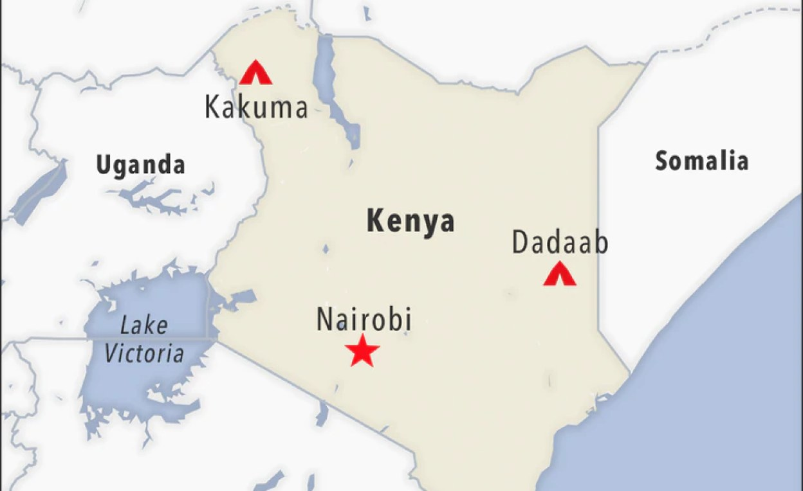
Notes:
Total refugees and asylum seekers-850,00 as of may 2025-around 1.4% of Kenyas population, are granted legal protection under national law
Kakuma-receives refugees from sudan
Dadaab-refugees from Somalia

Slide 6
RESULTS:SOCIODEMOGRAPHICS
Females:55%
Married: 48%
Christians: 59%
Mean age:33.9 years
The largest cadre was nurses:38%
The spouse was the modal source of emotional support
Notes:
Oldest was 50
Youngest was 22

Slide 7
WORK-RELATED FACTORS
54% had worked for less than one year
83% worked for between 40-50 hours a week
48% rated their workload as high
48% rated work as stressful, particularly night shifts
HELP-SEEKING BEHAVIOUR
54% rated their current general health as good
82% sought general healthcare services in the preceding year
23% had sought mental health services

Slide 8

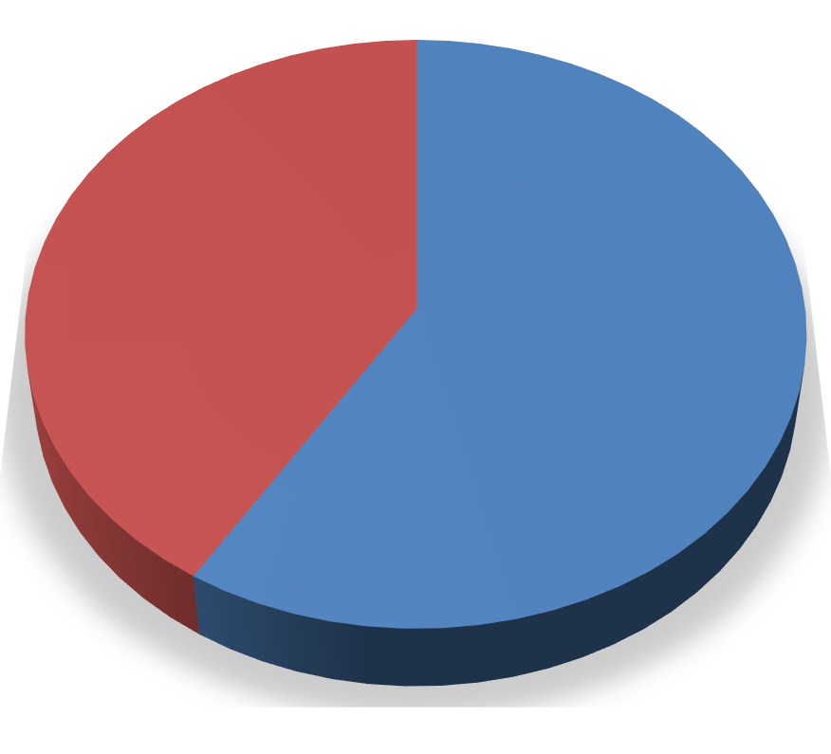




PREVALENCE OF DEPRESSION,PTSD
PTSD
41%
59%
NO PTSD
PTSD
Notes:
Depression:31% (n=38) of the respondents had depression. Cut off being at14 and higher. Of these, 39%(n=15) had mild depression,42%(n=16) had moderate depression and 19%(n=7) had severe depression.
General population 5%
PTSD: 41% (n=51) were above the cut-off point which is 33 or higher and may benefit from further PTSD assessment and treatment.
General population:3.9%

Slide 9


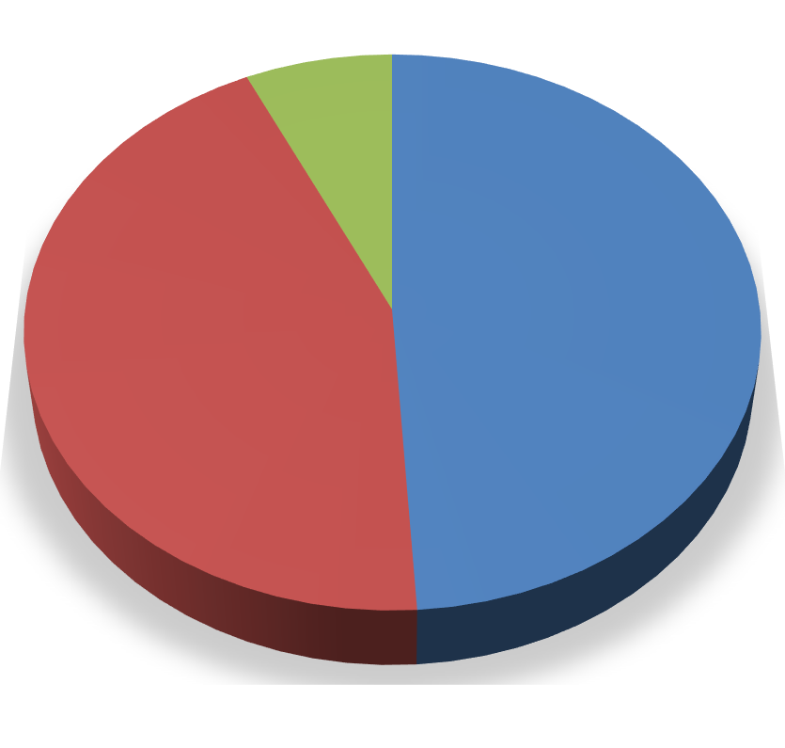
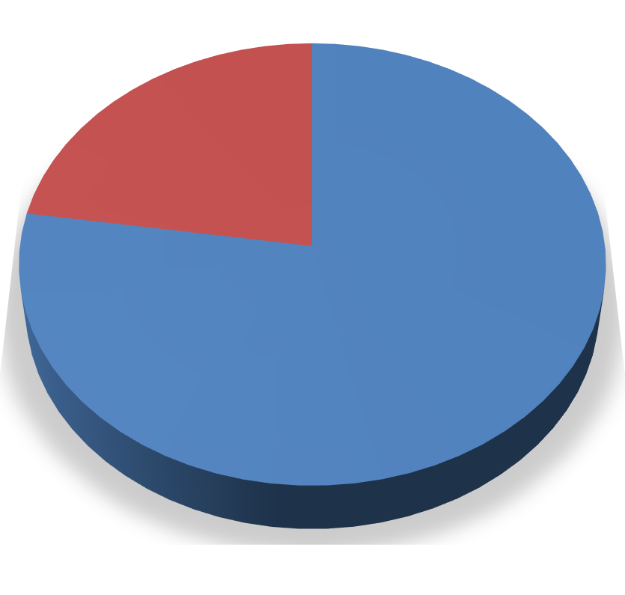








PREVALENCE OF BURNOUT
EMOTIONAL EXHAUSTION
DEPERSONALIZATION
23%
77%
HIGH
7%
LOW 49%
MODERATE 44%
LOW MODERATE
HIGH
HIGH
MODERATE
Notes:
EMOTIONAL EXHAUSTION: 7%(n=8) scored highly for emotional exhaustion,44%(n=56) scored moderately while 49%(n=60) had a low score.
DEPERSONALIZATION: 77% (n=96) had high scores while the minority, 23% (n=28) had moderate scores for depersonalization.
PERSONAL ACCOMPLISHMENTS: All 124 respondents had high scores for personal accomplishment.

Slide 10
DISCUSSION
A prevalence of 38% for depression,24% for emotional exhaustion, 19% for depersonalization amongst HAWs in Sudan.(Strohmeier et al.,2018 )
26% of humanitarian aid workers in Uganda presented with PTSD symptoms (Ager et al., 2012)
Individual factors:
Majority of HAWs in all settings are female and nurses (WHO, 2024)
Female HAWs in Jordan had an increased odds of experiencing clinical depression, burnout, anxiety and PTSD. (Eriksson et al., 2013)
Notes:
Compare the above with my study results

Slide 11
Work-related factors:
Workloads, poor work-life balance, and role strain were important contributors to psychological distress (Brooks et al., 2015);(Curling & Simmons, 2010)
Help-seeking behaviour:
less than 20% of HAWs in Bangladesh sought mental support despite approximately 50% of the respondents indicating they needed support. (Parvin et al., 2022)
Notes:
-high workload, stressful shifts, and unfavourable shift organizations on the BDI, MBI, and PTSD scales scores showed a direct and incremental relationship
-study results showed that only 23.4% sought mental health services.

Slide 12
LIMITATIONS
The tool was given online, hence over-reporting or under-reporting symptoms- unconscious bias
The study was conducted amongst a small subset of humanitarian aid workers –healthcare workers
Notes:
More studies in this topic are encouraged to help mitigate this

Slide 13
CONCLUSION
A significant number of HAWs suffer from depression, PTSD and burnout
Contributing factors: high staff turnover, heavy workloads, stressful shifts, and mental health-seeking behavior
Dearth of data among HAWs providing health care in Kenya

Slide 14
RECOMMENDATIONS
Continuous wellness programs and regular mental health screening amongst HAWs
Timely referrals for psychiatric interventions to those in need
Facilities to provide better working environments
Need for more studies on HAWs in Kenya
Notes:
Appraisal of workforce health status important
Better work environment: work life balance,manageable workloads and favourable shifts

Slide 15
ACKNOWLEDGEMENTS
Supervisors-Dr John Mburu,Dr Teresia Mutavi
Chiromo Hospital Group management team
HAWs-kakuma and Dadaab Refugee camps-International Rescue Committee
Kenya Psychiatric Association

