Slide 1



Increasing Access to Mental Health Services by Capacity Building and Community Integration: Insights from Kilifi County, Kenya.
Authors: Tatu Ann, Gitia Stella
Co-Authors: Gaitho Michael, Dr Oyaro Patrick, Njiru Perminus, Kibirige Nuru
Kenya Psychiatric Association (KPA) Annual Scientific Conference
3–5 September 2025 | Eldoret, Kenya

Slide 2
Background and Significance.
According to the WHO, 1 in 8 people around the world are living with a mental health disorder. With anxiety and depression being the most common. ( WHO, 2019)
Outpatient workload in Kilifi County: 0.9M; only 0.3% (3,179) diagnosed with MH conditions. (KHIS, Oct 2024-June 2025)
Barriers: limited personnel, stigma, poverty, and underfunding for MH.
Impact: Missed early identification and delayed care for Mental Health cases.
0.3%
Empowered, Healthy and Resilient Communities

Slide 3
Problem and Objective.
Training
Integration
Linkage
Mental Health issues are common among People Living with HIV. Depression, Anxiety, and Trauma can negatively affect treatment adherence.
Can continuous capacity building + community integration improve screening, identification, and referral speed?
Objective: Train HCPs, members of the community, and integrate MH screening in routine care, strengthen referral Pathways and follow‑up.
Empowered, Healthy and Resilient Communities

Slide 4
Intervention Components
Trained 66 HCPs + 51 community members using MH manuals co-created by the Division of Mental Health, HCPs, Community Members, and LVCT Health Group.
245 HCWs have been sensitised through CMEs/ OJTs.
Skills Gained: PHQ‑9/GAD‑7 Screening, Psychological First Aid, basic counselling/communication/ community-based psychoeducation/ Mental Health referral, documentation, and linkage systems.
Systems: registers, referral/linkage, structured follow-up, supervision.
Interventions supported by county leadership.
Empowered, Healthy and Resilient Communities

Slide 5
Integration into Routine Care
Screen(PHQ-9/ GAD-7)
Document
PFA
Refer(if moderate to severe)
Linkage/ Follow up
Screening embedded in triage/consults; standardized referral booklets/ KEMR.
Clear referral pathways; faster linkages to psychological care.
Ongoing mentorship/ OJTs and peer support.
Empowered, Healthy and Resilient Communities

Slide 6
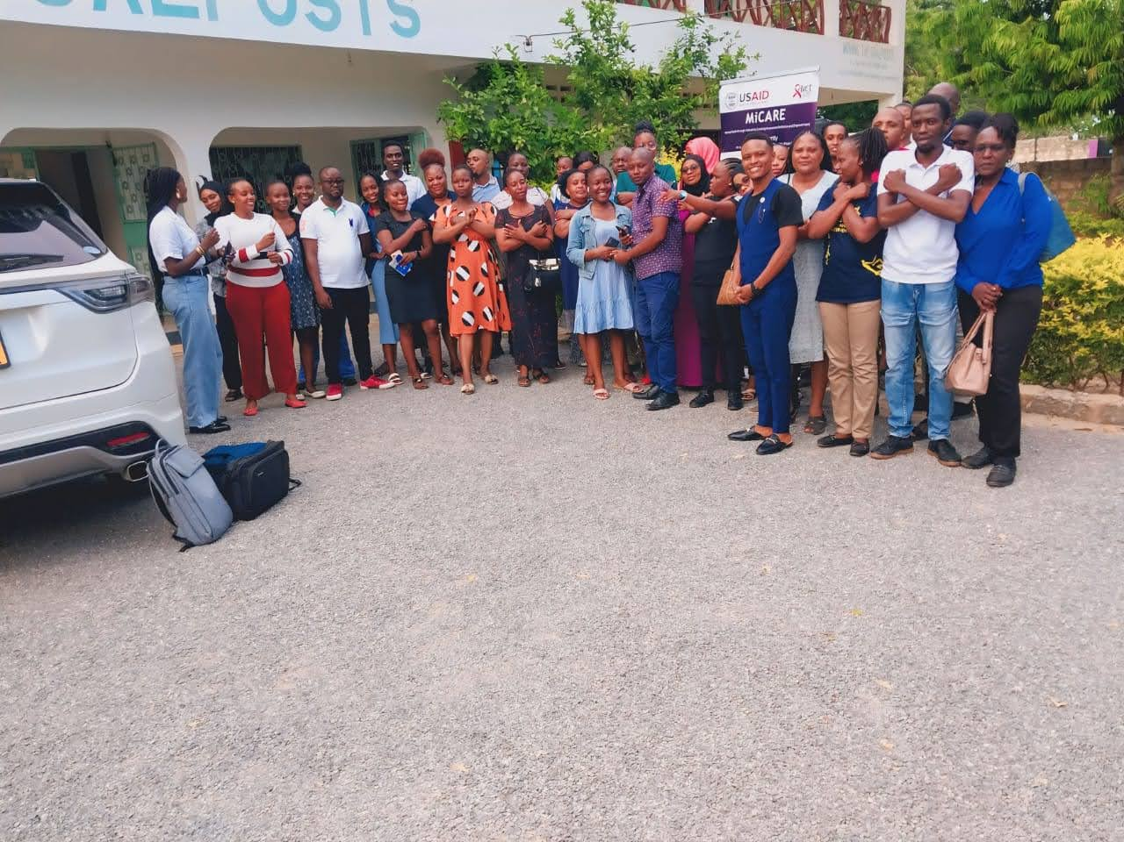
Community Engagement
Community cadre trained for psychoeducation and navigation.
Focus: General Population(AYPs, Men), PLHIV.
Observed: reduced stigma, Increased referral, increased self-reporting/help-seeking.
Empowered, Healthy and Resilient Communities

Slide 7
Results: MH Screening
PHQ-9 and GAD-7 Screening rose by 85%
Source: KEMR, 2025.
Empowered, Healthy and Resilient Communities

Slide 8
Results: Positivity Rates
Newly Identified Mental Health Cases increased as follows:
Depression 46 → 192
Anxiety 26 → 107
Source: KEMR, 2025.
Empowered, Healthy and Resilient Communities

Slide 9

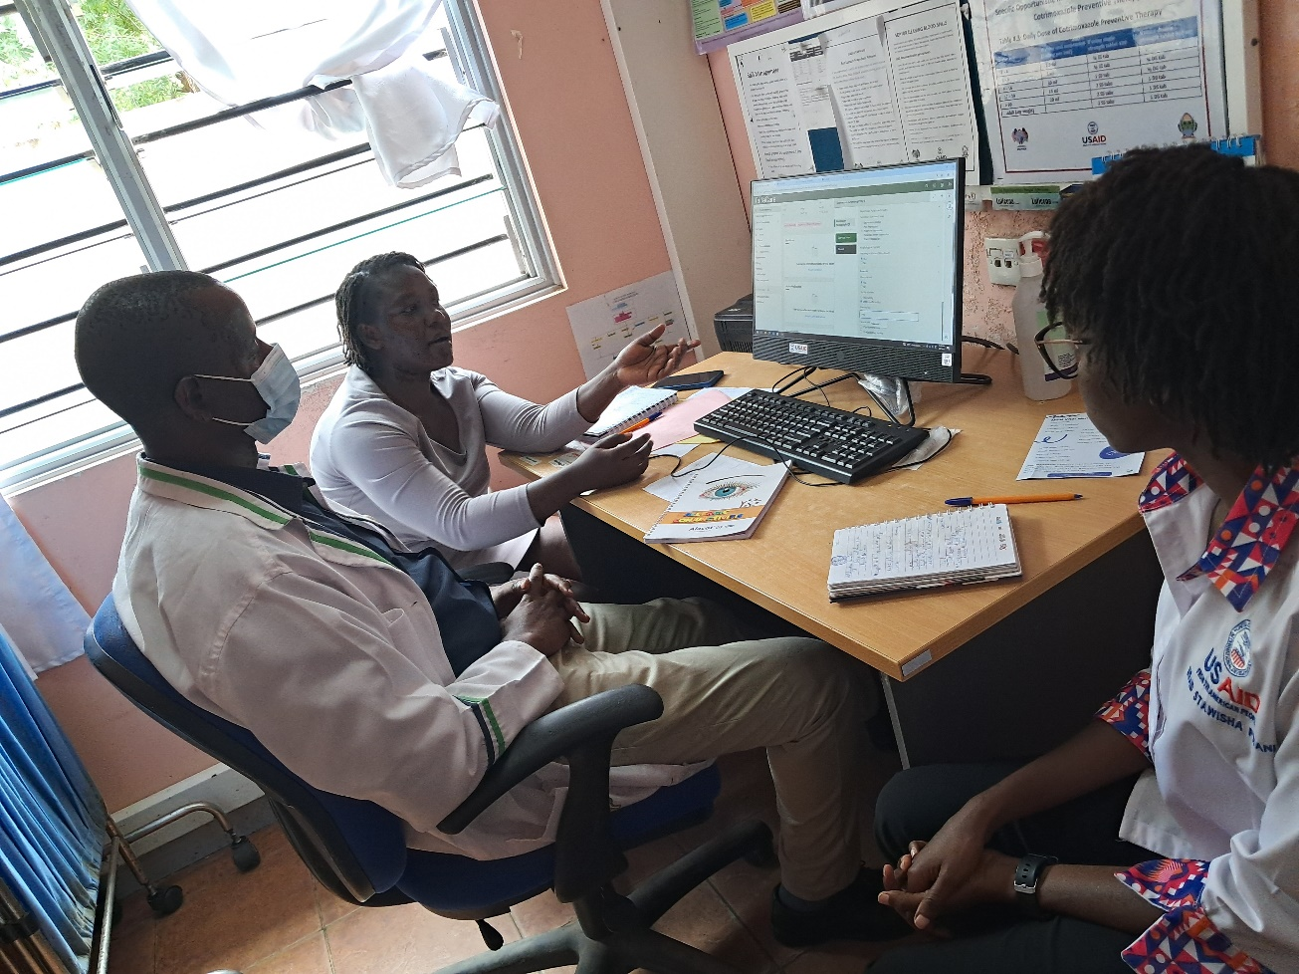
Discussion/ Interpretation
Continuous capacity building + workflow integration drove sustained gains.
System shifts: normalized screening, stronger documentation, clearer linkages.
Culture shift: more help-seeking among key groups.
Limitations: routine data quality; outcomes beyond referral not yet tracked.
Empowered, Healthy and Resilient Communities

Slide 10
Conclusions
Integration
Community
Capacity
Screening reach increased by 85% with the case identification rising by 76%
Referral time was also seen to reduce due to faster access to psychological care.
Sustainable model = ongoing mentorship + institutional support + community engagement.
Empowered, Healthy and Resilient Communities

Slide 11
Future Work & Acknowledgments
Plans to sustain mentorship; expand to more facilities, and outcomes (symptom change, retention).
Great Appreciation to the County Health leadership, LVCT Health-USAID Stawisha Pwani, trained HCPs, and community members.
Empowered, Healthy and Resilient Communities

Slide 12
Thank You!
“This Presentation is made possible by the support of the American people through the United States Agency for International Development (USAID) and the U.S. President’s Emergency Plan for AIDS Relief (PEPFAR). The contents are the responsibility of LVCT Health and do not necessarily reflect the views of USAID, PEPFAR or the United States Government.”

