Slide 1



Youth and School Mental Health Project: A Model for Strengthening Adolescent Mental Health Support in Kenyan Schools
Faith Njiriri
17th Annual Kenya Psychiatric Association Conference
Eldoret, Kenya
September 2025

Slide 2
Introduction: Youth and Adolescents Mental Health
-50% of mental health problems are established by the age of 14 years
-75% by the age of 24 years
-Adolescents in Kenya face increasing mental health difficulties from
-Academic pressures
-Peer pressure
-A rise in substance use among young people
-Socio-economic hardships; dysfunctions families
-Stigma and low mental health literacy
-This prevents early detection and timely intervention for mental health problems.

Slide 3
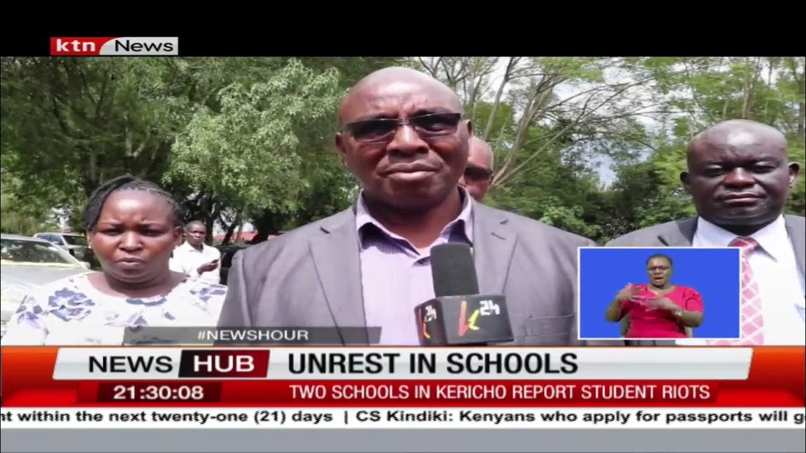
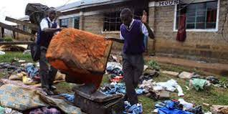
Why focus on Schools Now
In 2021 alone more than 30 schools were closed due to unrest in schools.
School environment is organized, allows better learning.

Slide 4
Youth and school’s mental health program
Overall goal: Expand access and quality of care for adolescent and youth mental illness and substance use
Create awareness
Build Capacity
Increase access to quality mental health care

Slide 5
Implementation process
We implemented the program in five phases:
curriculum adaptation,
(2) program implementation,
(3) teacher-led curriculum delivery,
(4) follow-up, and
(5) linkage to care. We adapted the African School Mental Health Curriculum through a participatory process into eight modules

Slide 6
i)Curriculum adaptation process
We adapted the African School Mental Health Curriculum through a participatory
Stakeholder engagement meeting with
-Teachers
-Teachers service commission
` -Ministry of Education
-Ministry of Health
Eight modules covering stigma, mental disorders, and counselling skills

Slide 7
ii) Program Implementation
Reviewed various existing curriculums and settled on the African School Mental Health Curriculum.
Got blessings from department of health and Ministry of Education.
Target schools selection with MOE
Initial stakeholder engagement forum with MOE, department of health, TSC, and school representatives.
Smaller implementation Committee formation and quarterly meetings to review content and monitor implementation.
Periodic feedback reports with MOE, TSC and Department of health.

Slide 8
ii)Teacher Trainings
Using a Trainer of Trainers (ToT) model, we trained teachers to deliver the curriculum in schools. We conducted sensitizations in schools and in the community, targeting students, teachers and non-teaching staff.
o get an overview of mental health
To learn about different counseling approaches
To learn basic counseling skills
To practice different case scenarios and brainstorm in teams
To learn about mental health screening and referral

Slide 9
TRAINING MODULES FOR STUDENTS
Module 1: Understanding Mental Health and Mental illness
Module 2: The stigma and discrimination of mental illness
Module 3: Information on specific mental illnesses
Module 4: Experiences of mental illness
Module 5: Seeking help and finding support
Module 6: The importance of positive mental health
Module 7: Counselling treatment for Depression and mental illness

Slide 10
iv) Follow-up outcomes
The program engaged 48 schools, reaching 24,309 students, 8,126 parents, 1,486 teachers and non-teaching staff, and 18,093 community youth through sensitizations.
835 teachers were trained, with 24 schools actively delivering the curriculum.
Between July 2024 and March 2025: 12,302 students attended curriculum-based lessons, 4,564 students participated in group counselling, 156 students received one-on-one counselling and
30 students were referred for mental health care.
Schools tailored delivery of the curriculum to fit their programs.
Integrating the content into guidance and counselling sessions and life skills classes. Teachers reported greater confidence in addressing mental health problems, while students showed improved literacy and increased willingness to seek help. Strengthened school counselling services and referral pathways enhanced access to care.

Slide 11
Achievements so far
No of youth sensitized in schools: 24,309
Sensitized youth in community: 18,093
Sensitized teacher and non-teaching staff; 1,486
Parents:8,126
Teachers trained on Counseling and Curriculum:451
No of Schools Engaged: 48
48 Schools fully trained, 24 started implementing curriculum
835 teachers were trained

Slide 12
v) Linkage to care: Referral Pathway
Counseling Support/SUD Support Group run by teachers, supported by peers
Mentored Facility/Youth Friendly service
Higher level of care (MOH Referral Facilities)
Teacher Screens (Mental illness and SUDS)

Slide 13
Conclusion
The burden is huge
The resources are limited
Together we can make a difference
Interventions among the youth are promising
Our school mental health intervention can be scaled.
“ There is no health without mental health” WHO

Slide 14





Acknowledgements
AMPATH-Afya Ya Akili Mashinani(AYAM) Team
Teachers Service Commission UG County’
Ministry of Education UG County
Ministry of Health UG County
Implementation committee
Funders: Astellas Global Health Foundation

