Slide 1
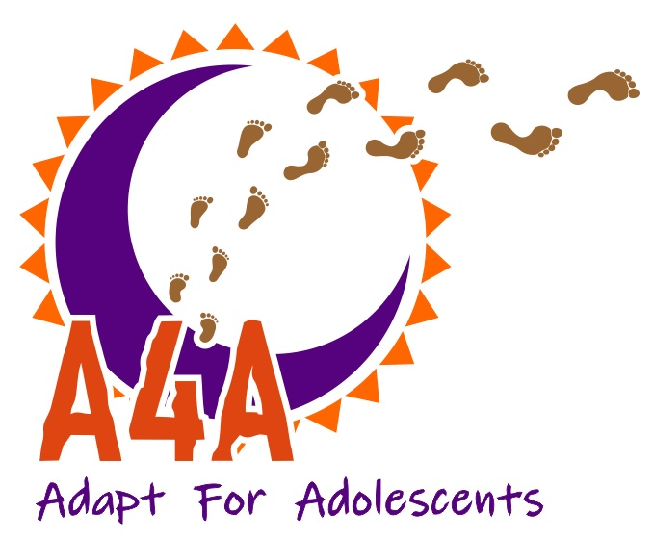
Enhancing Psychosocial Wellbeing and ART Adherence: The Critical Role of Peer Navigators in Supporting Adolescents with HIV in Western Kenya
Center for Microbial Research, Kenya Medical Research Institute,
Department of Obstetrics, Gynecology, and Reproductive Sciences, University of California, San Francisco, CA, USA
Department of Pediatrics, University of Colorado, Denver,
Division of Oncology, Department of Medicine, Washing ton University in St Louis, MO, USA
School of Medicine, Washington University, St. Louis, MO
Department of Child, Family, and Population Health Nursing, School of Nursing, University of Washington, Seattle, WA, USA
Department of Global Health, University of Washington, Seattle, WA, US
Gladys Ontuga¹, Harriet Fridah Adhiambo^{1,6}, Jayne Lewis-Kulzer², Dorothy I. Mangale⁴, Norton Sang¹, Edwin Nyagesoa¹, Arnold Muhinji¹, Elizabeth Bukusi¹, Elvin H. Geng^{5 ,} Lisa Abuogi³, Zachary Kwena¹
3rd Sept 25

Slide 2
Introduction & Background
Adolescents and Young Adults living with HIV (AYAH) face intersecting psychosocial challenges affecting mental wellbeing and ART adherence.
In resource-limited settings like Kenya, psychosocial wellbeing integration into HIV care remains limited.
Peer navigation, led by trained individuals with lived experience, provides contextual, empathetic, and targeted support.
Growing evidence suggests peer-driven approaches improve adherence and reduce stigma, yet their role in psychosocial wellbeing remains underexplored in Western Kenya.

Slide 3
In-person Peer Navigation Model
Target: AYAH (14–24 years) living with HIV.
Approach: Face-to-face support from trained peer leaders with shared lived experience.
Components: Basic counseling, health education, supportive relationships, and home visits.
Structure: Biweekly meetings (2 months), then monthly.
Outcomes: Better adherence, retention, and engagement in HIV care.

Slide 4
Research Gap, Significance, and Research Question
Research Gap:
Research Question:
Limited evidence on the impact of peer navigation on the psychosocial well-being of AYAH in Kenya
Current HIV care frameworks inadequately addressing mental health and stigma in resource-limited settings
Significance
Focus on the psychosocial dimensions of HIV care
Potential to strengthen ART adherence and enhance mental health outcomes among AYAH
How does peer navigation influence the psychosocial wellbeing and ART adherence among AYAH in Western Kenya?
Hypothesis:
Peer navigation improves psychosocial wellbeing, reduces stigma, and enhances ART adherence among AYAH.

Slide 5
Study Design & Setting
Design:
Qualitative study using in-depth interviews (IDIs) and focus group discussions (FGDs).
Exploratory approach to capture lived experiences, perceptions, and narratives.
Setting:
3 HIV care facilities implementing adolescent-friendly HIV services in Western Kenya (urban and rural).
Participants:
Adolescents and young adults aged 14-24 years living with HIV (AYAH).
Peer navigators actively involved in supporting AYAH.
Health care providers working in adolescent HIV care.

Slide 6
Materials & Key Procedures
Key Procedures:
Ethical Approval & Consent – IRB clearance obtained; informed consent/assent administered.
Recruitment – Purposive sampling to ensure diverse age, gender, and ART experience representation.
Data were collected using semi-structured IDI and FGD guides (AYAH, peer navigators, and healthcare providers), recorded with audio devices, and analyzed with NVivo software.
Data Analysis .
Thematic analysis, guided by the COM-B model, revealed that AYAH behaviour change depends on capability, opportunity, and motivation, with key themes of psychosocial wellbeing, adherence, and stigma
Capability
Behaviour
Motivation
Opportunity

Slide 7
Findings: Results organized under the COM-B framework.
Participants -20 AYAH (ages 16–24) mostly single, had primary to college education, 5–17 years on ART, and varied viral load outcomes. In addition, 25 health care and research staff (ages 23–52) with secondary to university education had extensive HIV, PMTCT, and peer navigation experience.
Capability (Skills, knowledge, and confidence to engage in behaviors)
Strengthened Peer Navigator Capacities: Training, mentorship, and collaboration improved navigators’ ability to address stigma, disclosure, IPV, and psychosocial well-being.
Enhanced Skills Among AYAH: Improved emotional regulation, communication, self-management, and clinic attendance.
Self-efficacy Development: AYAH reported increased confidence in managing health challenges and ownership of their care journeys.
Quote: "When my peer checked on me, I remembered to take my drugs, even on bad days.”

Slide 8
Findings-cont:
2. Opportunity (External factors that enable or hinder behavior)
Safe and Supportive Spaces: Peer navigation created non-judgmental spaces that encouraged openness and reduced feelings of isolation.
Delivery Modalities: Both phone-based and in-person sessions provided support, with in-person perceived as deeper and more effective.
Family and Community Involvement: While some AYAH appreciated family inclusion, others preferred private sessions due to stigma and confidentiality concerns.
Barriers to Support: Limited financial resources, relocation, communication issues, and gender dynamics sometimes disrupted the intervention.
Quote: "People still whisper… so I keep my status to myself."

Slide 9
Findings-cont:
3. Motivation (Internal processes that influence behavior)
Trusting Relationships: Strong bonds between navigators and AYAH fostered motivation, trust, and sustained engagement.
Identity Transformation & Empowerment: Peer navigation contributed to AYAH feeling more empowered and developing positive self-identities.
Reduced Internalized Stigma: AYAH felt understood, less judged, and more motivated to adhere to ART and engage in care.
Confidentiality Concerns: Fear of disclosure, especially through facility identification or phone communication, threatened trust and motivation, requiring adaptive strategies.
Quote: “I have not had so many problems since they started helping me. I have not encountered alot of problems. Even if it is a slight stress, I just look at how I can handle it and then they
advise me to get rid of anything that can give me stress”
.

Slide 10
Findings-cont:
Behavioral Outcomes & Health System Gaps
Peer navigation improved engagement, clinic attendance, and ART adherence.
Disruptions arose from inconsistent appointment scheduling and poor communication.
Limited adolescent-friendly spaces in adult clinics reduced satisfaction.
Strengthening health systems is key to sustaining progress.
Quote: "In the adult clinic, no one smiles or asks how school is going."

Slide 11
Discussion & Interpretation
The impact of peer navigation on the psychosocial well-being of AYAH in Kenya remains underexplored, with existing HIV care frameworks insufficiently integrating mental health and stigma reduction in resource-limited settings.
Findings in Context:
  The role of peer support aligns with literature showing improved ART adherence and retention among adolescents engaged in peer-led interventions (Willis et al., 2019).
  Persistent stigma and fear of disclosure echo earlier reports highlighting stigma as a key driver of disengagement (UNAIDS, 2021).
  Systemic gaps—like poor scheduling and lack of adolescent-friendly services—are consistent with WHO recommendations emphasizing youth-centered care as essential for better healthcare outcomes.
Interpretation:
  Addressing stigma and provider continuity is as important as medication access.
  Without systemic changes, adolescents remain at high risk for treatment interruption and poor outcomes.
  Embedding trained peer navigators into HIV programs could address the overlooked psychosocial dimension of care.

Slide 12
CONCLUSION
Peer navigation addresses psychosocial barriers to HIV Care among AYAH.
Strengthened navigator capability through structured training enhances targeted support.
Trusting relationships between navigators and AYAH are central to sustained engagement in care.
Barriers include financial constraints, mobility, and confidentiality concerns.
Embedding peer-driven psychosocial support in HIV care models can improve outcomes

Slide 13
Recommendations &Future Work
Recommendations:
Integrate peer navigation into HIV care guidelines
Train navigators on mental health & stigma
Ensure funding & sustainability
Monitor psychosocial + clinical outcomes
Future Work
Add mental health screening & referral
Assess long-term ART, viral & wellbeing outcomes
Explore digital tools (e.g., secure apps)

Slide 14
ACKNOWLEDGEMENTS
We extend our sincere gratitude to the AYAH who participated in this project, the Kenya Ministry of Health, and our collaborating partners for their invaluable support.
Research reported in this abstract was supported by the National Institute Of Nursing Research of the National Institutes of Health under Award Number R01NR018801
The content is solely the responsibility of the authors and does not necessarily represent the official views of the National Institutes of Health

Slide 15

Acknowledgements

