Slide 1
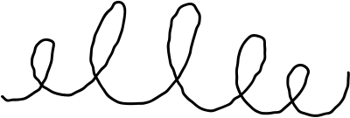






Beracah Wellness Consultancy
Elevating Health and Well-being through Innovative & Home-made Solutions and Support

Slide 2


Identity-as-Prevention
A Community-Led Parenting Model for Early Mental Health Intervention in Kenya
Workplace Wellness
Healthy Relationships
Intention Parenting
We focus on the whole person, integrating mind, body, and spirit for optimal health and well-being.
Our expert nutritionists provide personalized plans to help you achieve your health goals through balanced and nutritious eating.
We offer effective strategies and techniques for reducing stress, enhancing productivity, and fostering a positive work environment.

Slide 3



The Big Problem
  “Children must know who they are before the world tells them who to be.”
  7 in 10 children struggle with identity issues (UNICEF).
  Rising childhood distress in Kenya (2021 Taskforce).
“Identity is Prevention: Strong Roots, Strong Minds.”

Slide 4
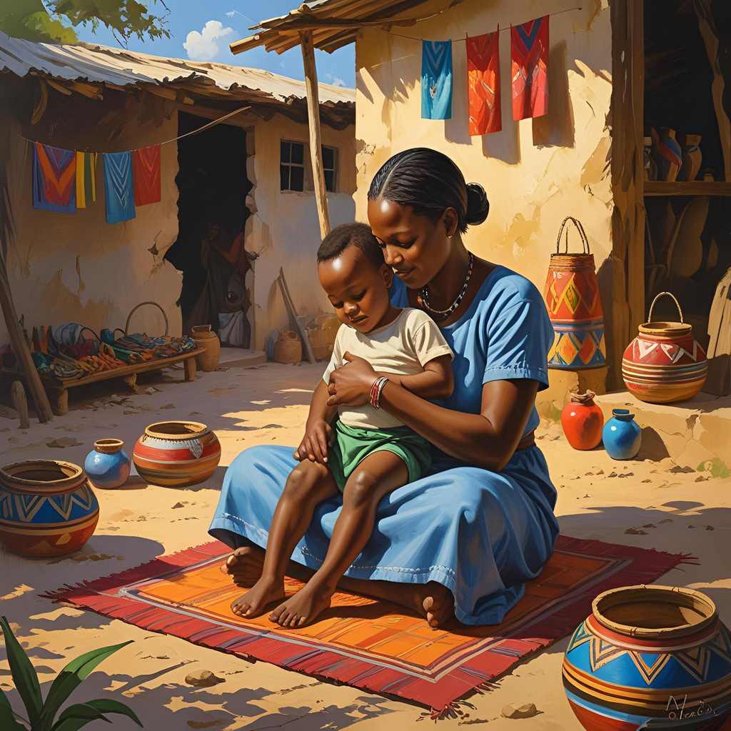
The Gap in Interventions
  Most are reactive, not preventive.
  Clinic-centered, not home/community.
  Culturally disconnected.
  Parents underutilized as first-line mental health promoters.
“Identity is Prevention: Strong Roots, Strong Minds.”

Slide 5
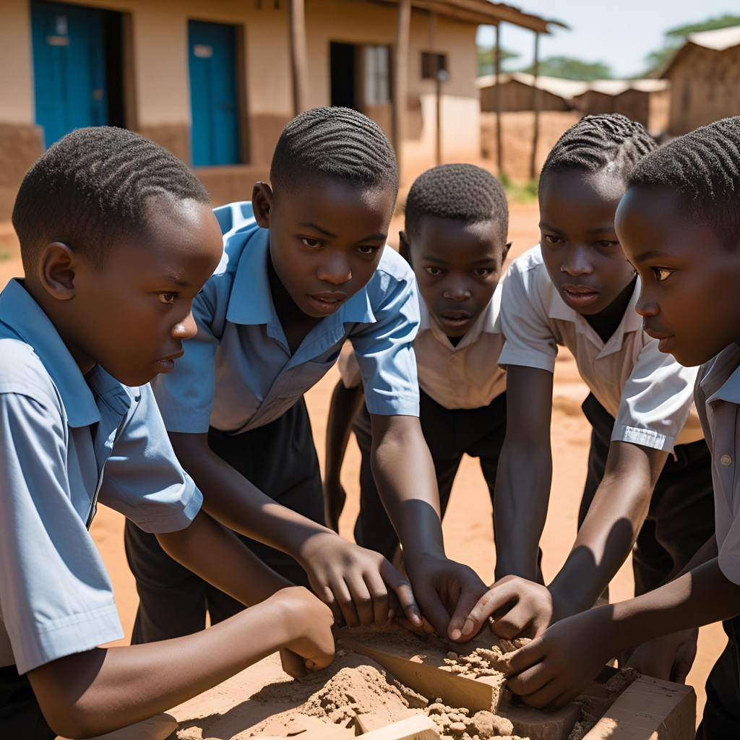
Introducing the Identity Series
  Most are reactive, not preventive.
  Clinic-centered, not home/community.
  Culturally disconnected.
  Parents underutilized as first-line mental health promoters.
“Identity is Prevention: Strong Roots, Strong Minds.”

Slide 6

Introducing the Identity Series
  7-Day Parenting Challenge (ages 5–12).
  Daily conversations + play activities.
  Parents reclaim role as mental health promoters.
  Simple, scalable, culturally grounded.
“Identity is Prevention: Strong Roots, Strong Minds.”

Slide 7
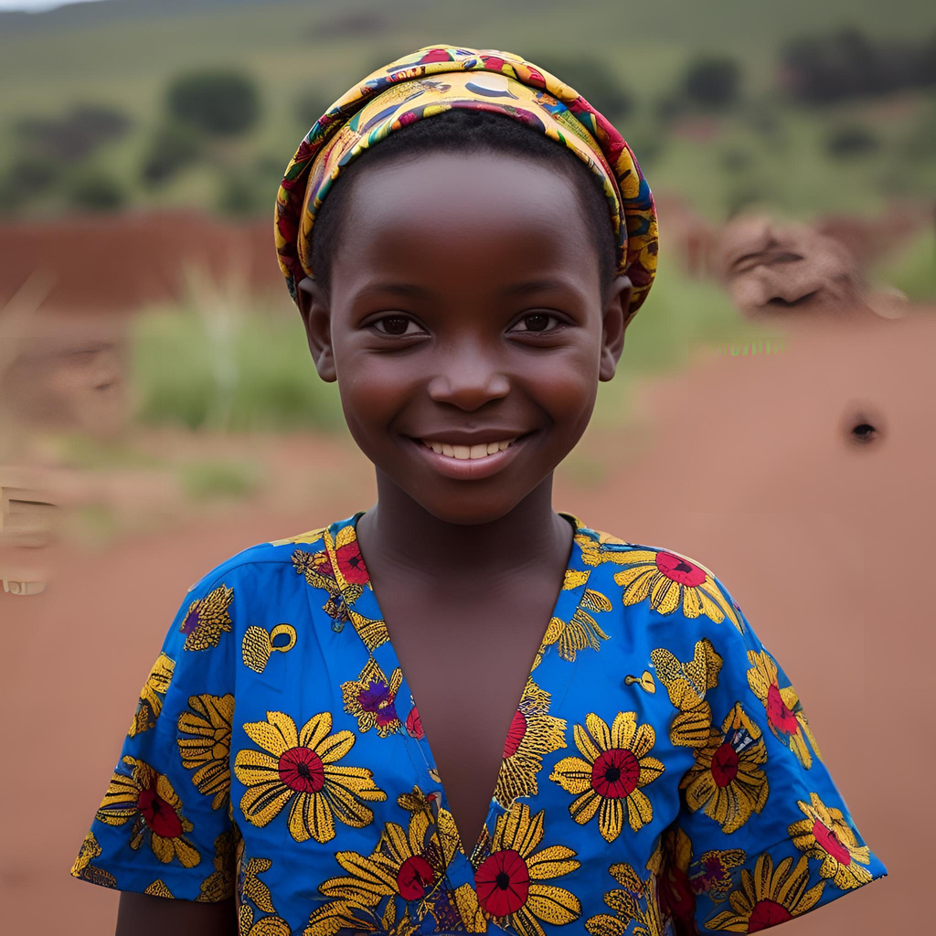
The 7 Pillars of Identity
  Name & Story
  Affirming Language
  Cultural Roots
  Strengths & Talents
  Values & Beliefs
  Resilience Through Failure
  Vision & Purpose
“Identity is Prevention: Strong Roots, Strong Minds.”

Slide 8




Sample Activity – The Bounce-Back Ball
  Write feelings of failure on balloon.
  Toss and bounce = resilience metaphor.
  Message: “Like this ball, you can always rise again.”

Slide 9
The Intervention Explained
  Prevention starts at home: parents as first-line mental health promoters.
  7-Day Challenge = daily doses of identity-building.
Identity reframed as psychological infrastructure → protection against distress.

Slide 10
How It Works
  Delivery: Guidebook, school programs, WhatsApp groups.
  Setting: Homes, classrooms, churches, communities.
  Facilitators: Parents, Older siblings, Guardians, teachers.
  Cost: Low (paper, crayons, balloons).
  Scalability: Easy to replicate anywhere.

Slide 11
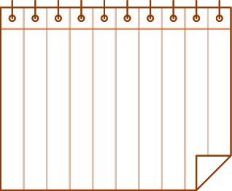


Why It’s Different
`Prevention at an early age
Community / Lay leaders Led
Cultural Resonance
Highly Scallable
Culturally grounded → African traditions & languages. Highly adaptable in any of our diverse cultures
Scalable & simple → fits daily life.
  “Vaccination for the mind” – daily identity doses.
Early → before problems manifest.
Community-led → parents, not just professionals.

Slide 12
Pilot Outcomes
  Children: stronger emotional expression, cultural pride, resilience.
  Parents: deeper bonds, empowered as caregivers, joy in parenting.

Slide 13
Why This Matters
  Identity is mental armor.
  Prevention must move from clinics → kitchens, schools, communities.
  Parenting = upstream mental health.

Slide 14
Call to Action
  Researchers: build evidence, evaluate outcomes.
  Policymakers: integrate into national child wellness programs.
  Communities: reclaim parenting as prevention.
  “Our kids’ dreams are powerful. Let’s give them wings to fly.”

Slide 15







THANKS
Benjamin Mutuku | Beracah Wellness Services
📧 beracahwellnesss@gmail.com
📞 +254 757 277 501 | +254 727 209 170
AUTHOR: BETTY AND BENJAMIN MUTUKU
TITLE: IDENTITY SERIES
SPEAKERS ON: INTENTIONAL PARENTING

