Slide 1

Before the Breakdown: Community-Driven Early Mental Health Support for Africans in Diaspora
17TH KPA ANNUAL SCIENTIFIC CONFERENCE
PROF F. G. NJENGA, DR C. GUMBO and MS. Z. KIMARI

Slide 2
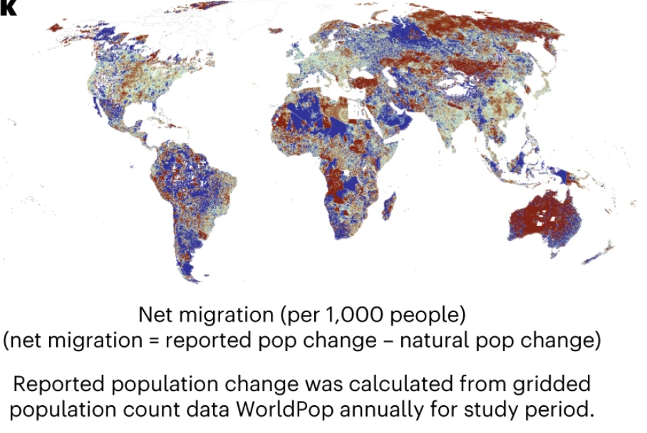
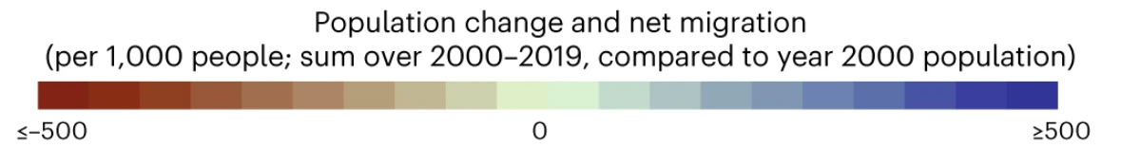
African Global Mobility Dynamics
An estimate of 200 million Africans form the African Diaspora Community
Drivers of motion include: professional, humanitarian and international agency
Contextual strains experienced: Cross-cultural adjustment, identity fragmentation, systemic discrimination
Notes:
Despite functional competence, many experience psychological distress and functional trauma.
Systemic blind spots and stigma around mental health within immigrant populations impede mainstream interventions

Slide 3

Problem Statement
Many African migrants face psychological distress and functional trauma, often undetected, misdiagnosed, misrepresented due to external presentation of functional competence
Cultural stigma and systemic mismatch further impede mainstream interventions
Early interventions are rare with many seeking help when in crisis.
Burden of unmet mental health needs within the African Diaspora

Slide 4
Study Objectives
Explore clinical patterns of psychological distress among African immigrants
Identify barriers to accessing culturally informed mental health care in host countries
Develop culturally sensitive, community- and peer-driven strategies for early intervention

Slide 5
Methodology
Retrospective mixed-method approach
100 anonymized clinical cases reviewed at CHG between Jan and April 2025
Inclusion criteria: African descent, aged 16–71, residing abroad
Exclusion criteria: Kenyan patients residing in Kenya, incomplete or insufficient case records
Selection process: record review and clinician discussions
Limitations: selection biases, lack of client voice, generalizability

Slide 6
Geographic Mobility Patterns
42% -USA and Canada
30% -Africa
20%- Europe
Australia, New Zealand, Asia (2% each)
Middle East (4%).
20% of the people we met had moved into Kenya
Notes:
In the past three months we connected with approximately 100 people who have either left or moved into Kenya for various reasons.

Slide 7
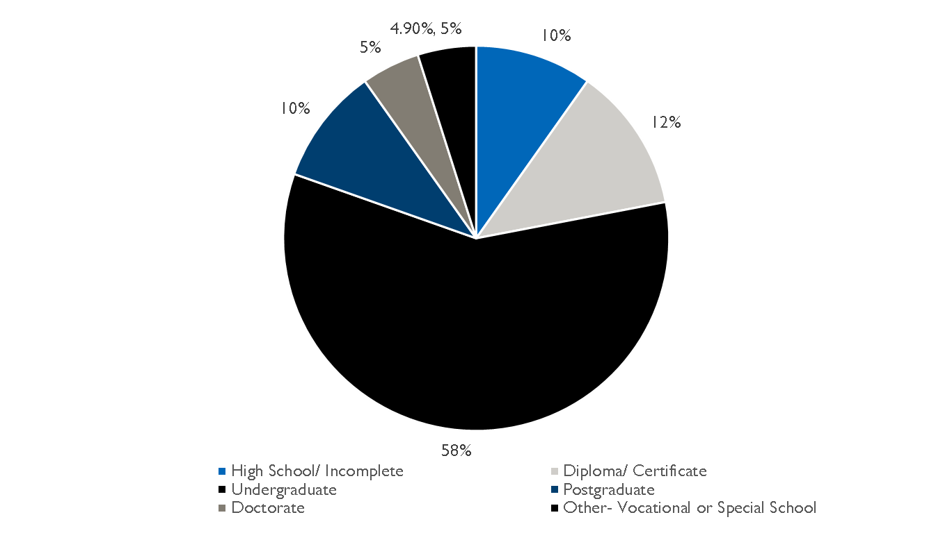
Age and Education Distribution

Slide 8
Care Entry Points
Comprehensive Psychiatric Evaluation
Services Inaccessibility in Host Country
Acute Psychiatric Response
Diagnostic Verification
Continuity of Care across Transitions
Psychosocial and Cultural Facilitation
Notes:
Comprehensive Psychiatric Evaluation
Initial diagnostic assessments initiated by clients, parents, or guardians.
Service Inaccessibility in Host Country
Limited availability or cultural misalignment of specialized mental health services abroad.
Acute Psychiatric Crisis Response
Immediate interventions for behavioural or psychiatric emergencies, including pre-travel crises.
Specialist Diagnostic Verification
Requests for expert second opinions to confirm or refine prior diagnoses and treatment plans.
Continuity of Care Across Transitions
Ongoing treatment during educational, occupational, or geographical transitions, including medical leave.
Psychosocial and Cultural Facilitation
Support in overcoming cultural barriers to diagnosis, stigma mitigation, and academic/career-related mental health facilitation.

Slide 9
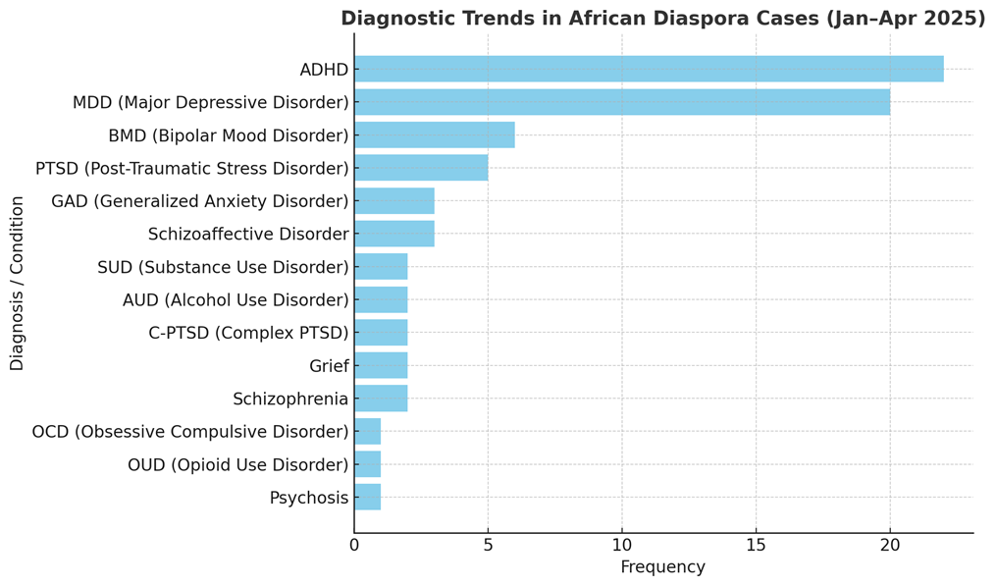
Diagnostic Landscape
Notes:
High prevalence of ADHD and Depressive Disorders.
Frequent presentations of PTSD, Bipolar Mood Disorder, Anxiety, substance use, schizophrenia and psychotic illnesses

Slide 10
Discussion
Complex clinical profiles influenced by migration stress
Escalating psychological distress from systemic barriers, mismatch and structural marginalization
Resounding impact of stigma, low mental health literacy, and provider cultural gaps
High prevalence of ADHD, depression, and mood disorders often masked
Adolescents migrating during sensitive developmental periods have higher vulnerability
Isolation and fragmentation consequent to emotional disconnection and cultural dissonance
Notes:
Complex psychiatric profiles in African migrants shaped by migration stress, intensified by restrictive U.S. immigration policies, refugee program suspension, and family separation trauma.
Escalating psychological distress from racism, xenophobic rhetoric, and social exclusion — disproportionately affecting African migrants.
Structural marginalization including detention, legal vulnerability and undocumented status compounds mental health challenges in diaspora populations.
Stigma, low mental health literacy, and provider cultural gaps remain major deterrents to help-seeking across diaspora contexts.
High prevalence of ADHD, depression, and mood disorders, with notable cases of PTSD, psychosis, and anxiety—mirroring global migrant mental health trends.
Adolescents migrating during sensitive developmental periods face heightened risk of severe mental illness, especially psychosis.

Slide 11
Conclusion
Culturally sensitive, trauma-informed, and tech-enabled care models improve wholistic mental health and functioning
When supported holistically, African migrants can thrive across borders

Slide 12
CHG: Advancing Community-Driven Mental Health Support for the African Diaspora
Caring across the borders- proving that hybrid, culturally responsive care models can address systemic stressors
Stigma reduction and strengthening cultural competence among care providers
Strength in Community to counter isolation and build resilience
The next steps- Co-designed services with diaspora communities, scaling peer networks, and forging cross-border partnerships for promotive-to-curative care.

