Slide 1


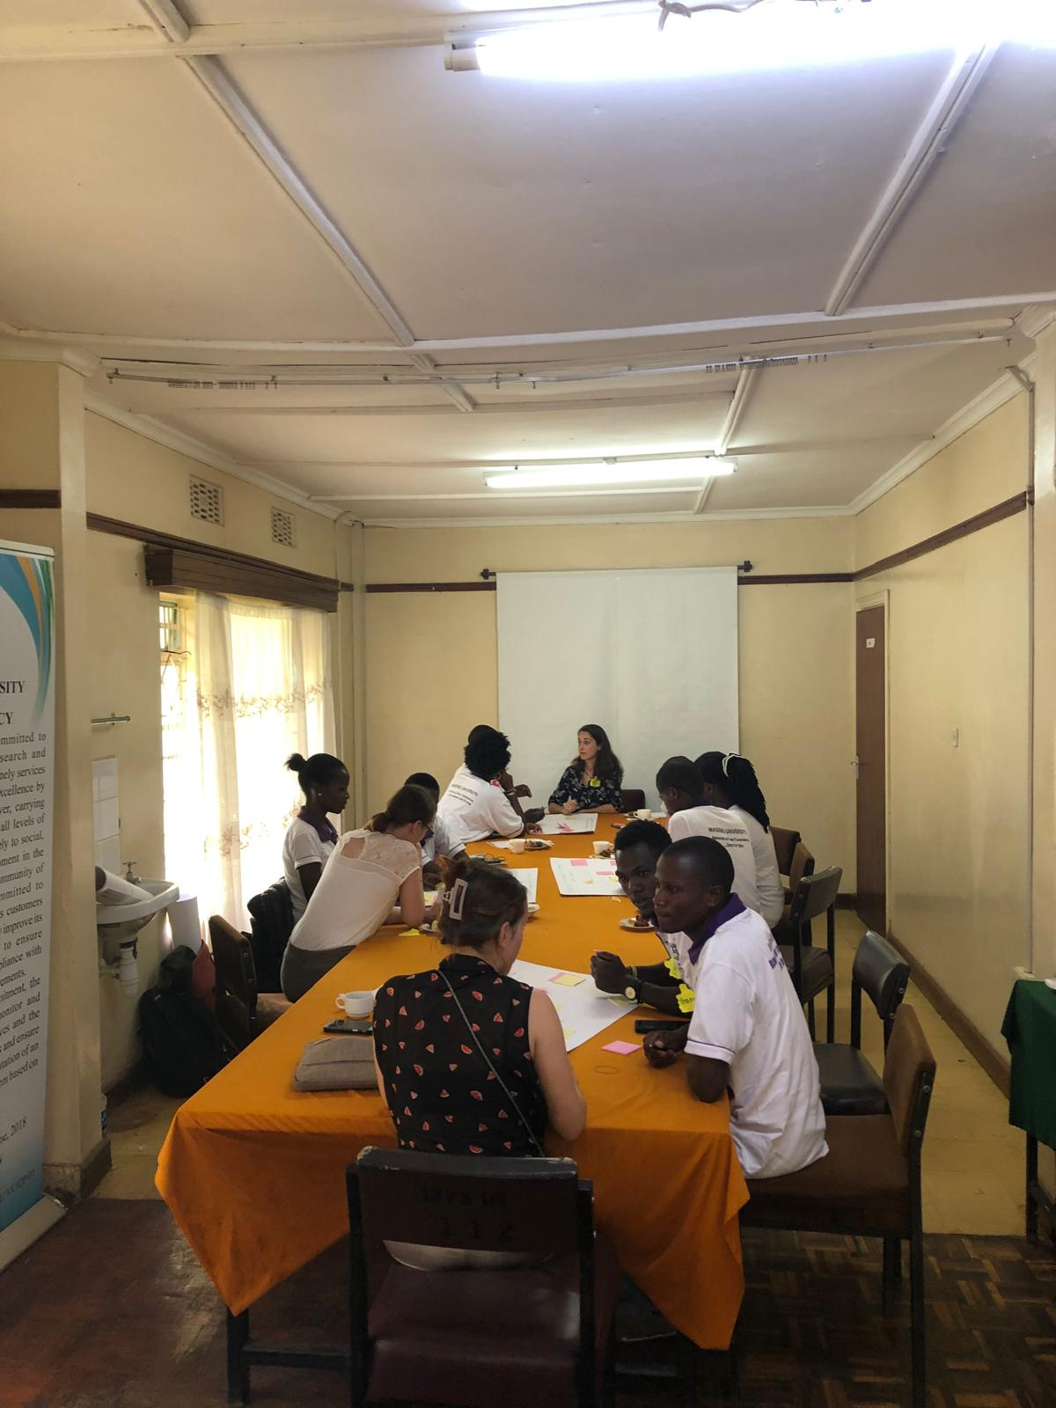
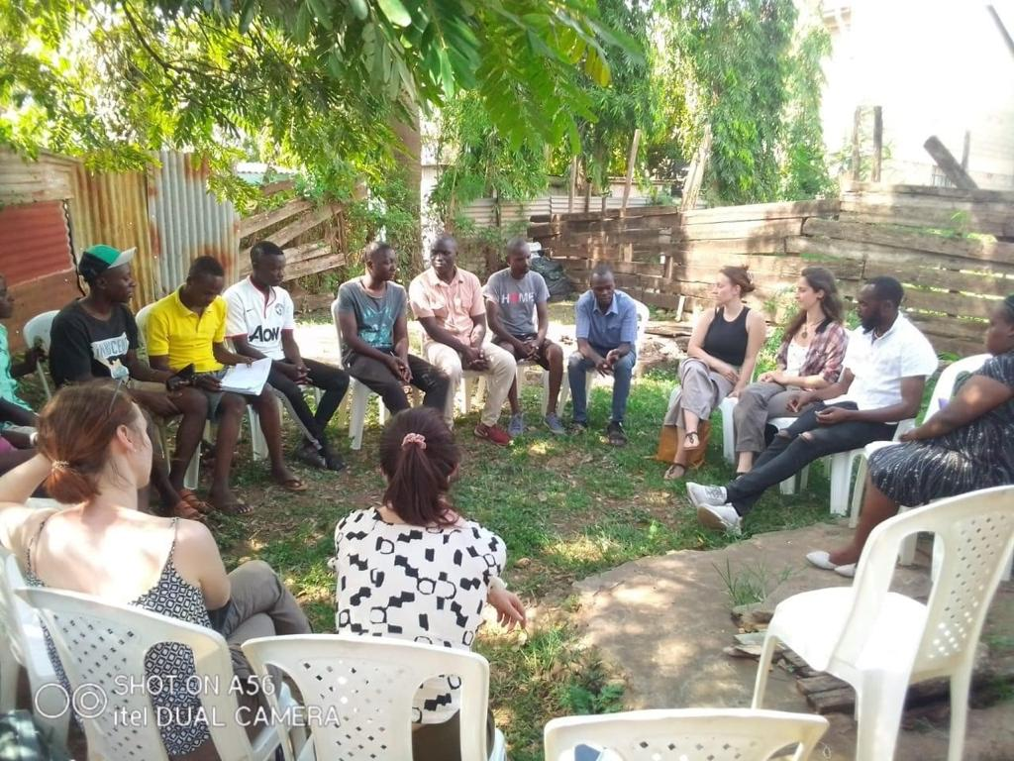
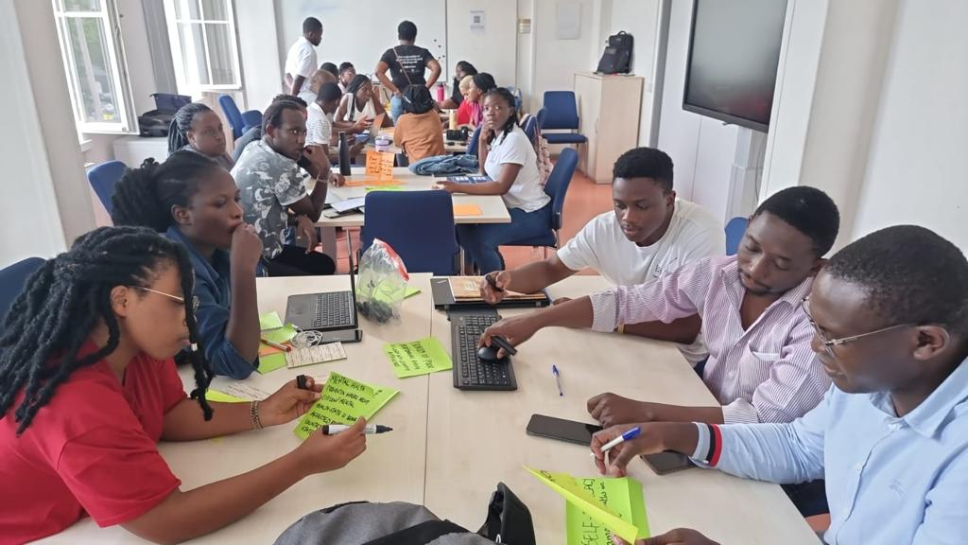
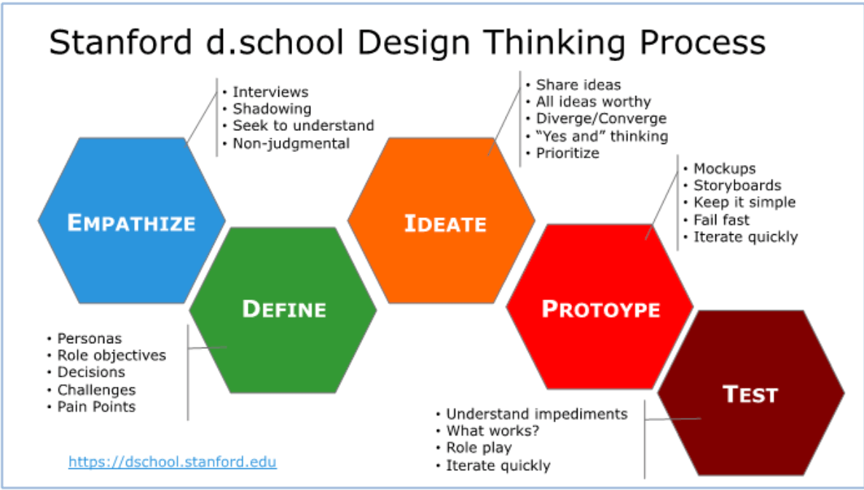
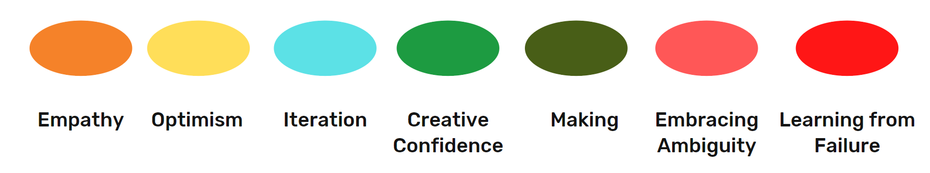
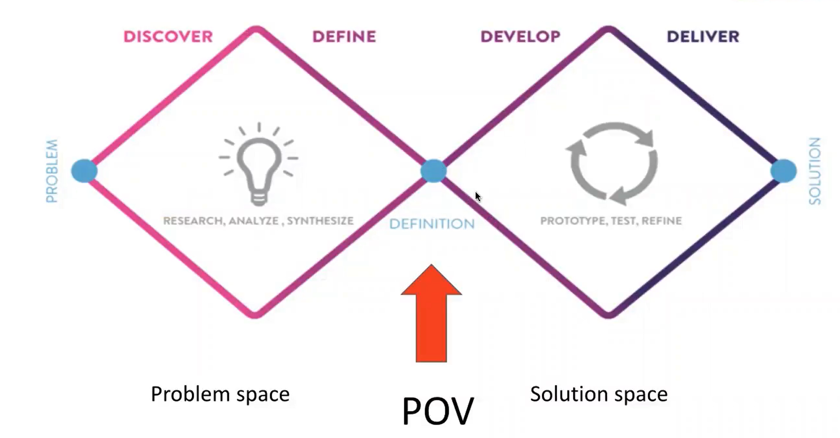
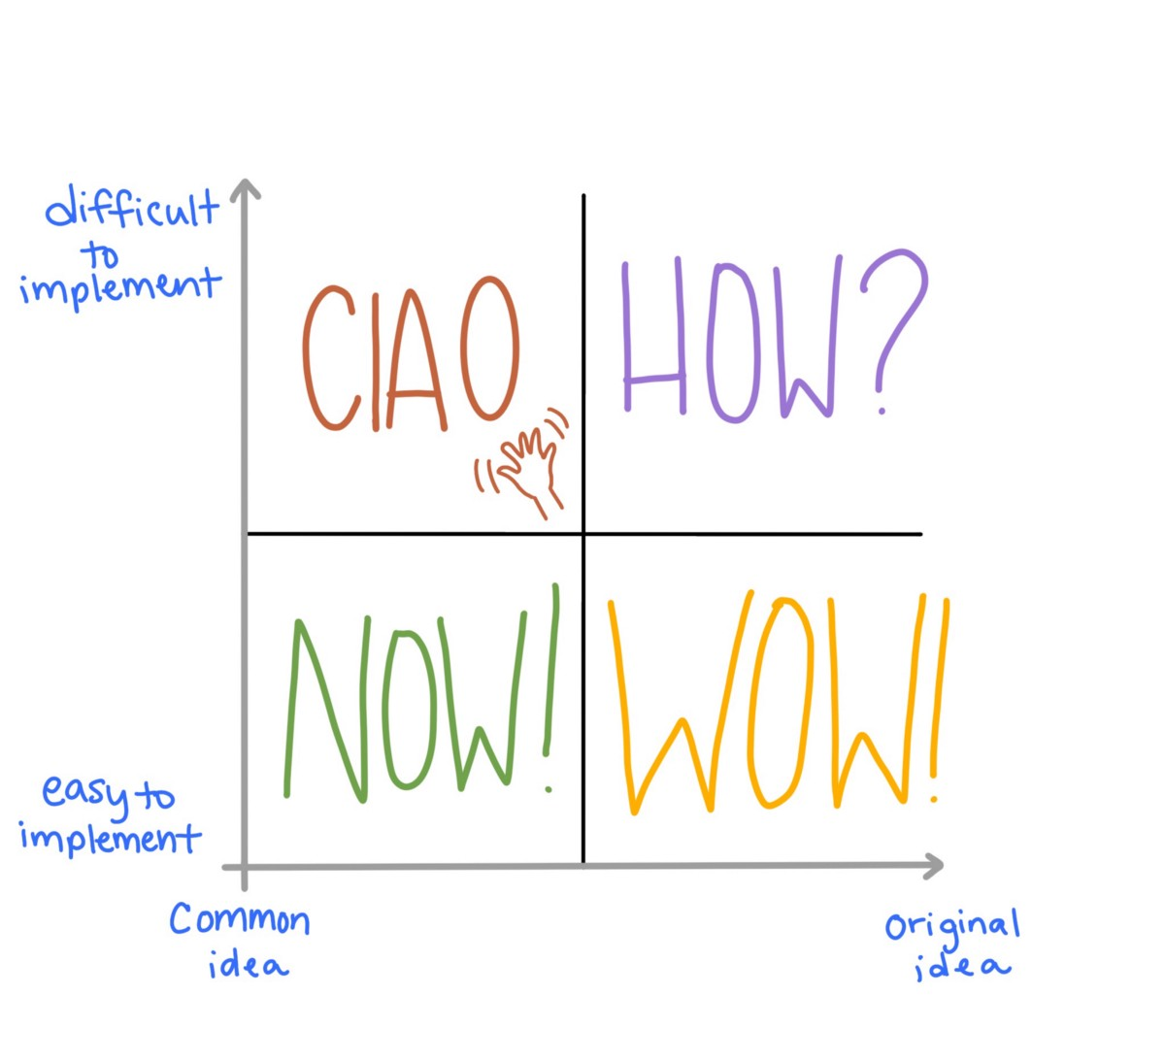



Catalyzing Community-Based Mental Health Solutions: The Erasmus+ Exchange and Incubator Journey
Rick Peter Fritz Wolthusen, On The Move e.V., Dresden, Germany; Philip Odoyo Nyaswa, Uzima University, Kisumu, Kenya; Rose Anyango Omolo Ongati, Maseno University, Maseno, Kenya; Gordon Kwesi Adomdza, China Europe International Business School, Accra, Ghana
Contact: info@on-the-move.de
Background
The Erasmus+ exchange program, implemented by On The Move e.V., fosters social innovation in mental health by equipping students and professionals from Kenya, Ghana, and Germany with the skills to design and implement community-based interventions. In collaboration with Maseno University and Uzima University, the program has engaged over 50 participants to date, providing hands-on training in Design Thinking and cross-sectoral collaboration to address mental health challenges in diverse contexts.
Methods
Participants applied Design Thinking methodologies to develop innovative mental health interventions tailored to their local contexts. The program emphasized human-centered problem-solving, stakeholder engagement, and iterative prototyping. To ensure sustainability, On The Move e.V., in partnership with StradMed Innovations and Ashesi University in Ghana, launched the Mental Health Venture Incubator (MHVI), a 12-week program offering mentorship, seed funding, and capacity-building support for project implementation.
Results
Participants developed and piloted several community-based mental health projects, including Tujumiize and the Maseno University Mental Health Policy.
The Maseno University Mental Health Policy project co-designed a culturally tailored mental health strategy for Maseno University, Kenya, using a participatory Design Thinking approach. Through workshops and interviews with stakeholders, the team identified key stressors and developed targeted interventions to strengthen campus mental health support systems.
Tujumiize is a youth-focused initiative in urban Kisumu, Kenya, aimed at reducing cannabis use among high school students aged 14–18. It combines peer pressure resistance training, mental health education, and school–community care linkages to decrease cannabis-related dropouts and behavioural issues.
1
Conclusion
This model demonstrates how international collaboration and experiential learning can drive scalable mental health interventions. Lessons learned from the program highlight the importance of participatory approaches, stakeholder engagement, and the integration of social innovation in mental health care. The MHVI ensures that these projects transition from concept to sustainable, community-driven solutions.
3
Upper right: photographs from the Tujumiize project and the Maseno University Mental Health Policy activities. Panels 1–4 illustrate key Design Thinking concepts: (1) the Design Thinking stages with associated tools for each stage; (2) the Ciao–How–Now–Wow matrix, an idea selection tool; (3) examples of Design Thinking mindsets; and (4) the double diamond diagram, a visual representation of the design and innovation process.
2
4
The authors have no conflicts of interest to declare. The Erasmus+ program is funded by the European Union and supported by the Leonardo Office of the Technical University of Dresden, Germany.

Slide 2
DECONSTRUCTING STIGMA: A CULTURALLY SENSITIVE APPROACH TO GLOBAL STIGMA REDUCTION IN
MENTAL HEALTH

