Slide 1

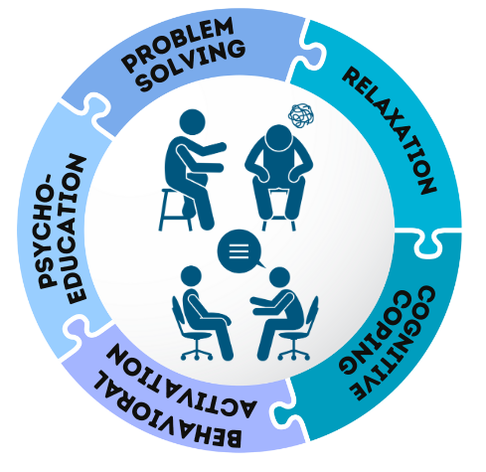


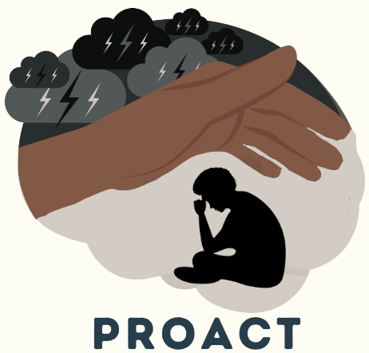
Correlates of Perceived Social Support Among Adolescents and Young Adults Living with HIV and Elevated Depressive Symptoms in Kenya
Psychoeducation, Relaxation, prOblem solving, Activation, and Cognitive coping
About This Presentation
Presenter(s): Jeffrey Osano
Topic: Perceived social support and depressive symptoms
Affiliation: University of Nairobi
Study Site: Nairobi, Homabay, Kisumu
Date: September, 2026
Sample Size: [N = 600]
Period: [Aug 2024 – Dec 2025]
PI: [Dalton Wamalwa (UoN), Pamela Collins (JHU), Muthoni Mathai (UoN)]
Funded by NIH • Grant #5R01MH133261-02
Grant #5R01MH133261-02

Slide 2




01
Background & Rationale
Context, burden, and the case for studying perceived social support
Depression Burden in AYA
Role of Social Support
Related Literature
• Adolescents and youth living with HIV experience a disproportionate burden of depression and treatment challenges compared to adults¹.
• Social support plays a critical protective role in mental health and treatment engagement.
• High levels of support are associated with improved self-esteem, better antiretroviral therapy (ART) adherence, and reduced suicidal ideation².
• However, AYA with elevated depressive symptoms may experience diminished perceived social support^{3, 4}.
• AYA living with HIV face a significantly higher risk of mental health disorders compared to their HIV-negative peers.
• Approximately one-quarter to one-third of AYA in HIV care settings meet the criteria for clinical depression, a rate that remains stable across East African cohorts^{5, 6}.
• HIV-related stigma — particularly internalized and anticipated forms consistently undermines perceived social support.
• Stigma creates social distance, leading AYA to withdraw from potential support networks to avoid disclosure or judgment⁷.
Grant #5R01MH133261-02

Slide 3


02
Objectives
What this analysis set out to examine
Perceived
Social Support
Objectives
• To examine perceived social support levels and the relationships between perceived social support, severity of depressive symptoms and other factors among adolescents and young adults (AYA) living with HIV in Kenya.
• Contributing to the limited literature on perceived social support among youth living with HIV and experiencing psychological distress.
Key Variable / Focus
Measured using the 12-item Interpersonal Support Evaluation List (ISEL-12) among AYA living with HIV and elevated depressive symptoms
Appraisal support: having someone to turn to for advice or guidance on a personal problem;
Belonging support: availability of someone to socialize or spend time with;
Tangible support: availability of material help such as help with chores
Target Population
• AYA aged 16–24 years living with HIV with elevated depressive symptoms (PHQ-9 ≥5)
• Enrolled across 30 HIV clinics in Kenya
Grant #5R01MH133261-02

Slide 4




04
Methodology
Study design, participants, measures, and analysis
1
2
3
4
Study Design &
Participants
Social Support
Measure
Depressive
Symptom Severity
Statistical
Analysis
Baseline data was analyzed from a trial conducted across 30 HIV clinics in Kenya. AYA aged 16–24 years with elevated depressive symptoms (Patient Health Questionnaire [PHQ-9] ≥5) were enrolled.
Perceived social support was measured using the 12-item Interpersonal Support Evaluation List (ISEL-12) – total (range: 0-36) and subscales: appraisal (0-12), belonging (0-12), and tangible support (0-12)..
Depressive symptom severity was categorized as mild (PHQ-9 scores: 5-9), moderate (10-19), and severe (≥19).
Bivariate regression analyses assessed associations between ISEL-12 scores and key covariates, reporting mean differences (MD) and 95% confidence intervals (95%CI).
Grant #5R01MH133261-02

Slide 5


05
Results & Outcomes
Participant characteristics & key outcomes
N = 600
64.3%
21
Study Population
Mild Depressive Symptoms
Median ISEL-12 Score (Moderate)
Study Population (N = 600)
Mental Health & HIV-related Factors
• Median age: 19.6 years (IQR: 17.7–21.9); 66.5% female
• 59.8% in school; among out-of-school: 75.8% unemployed
• 54.7% lost ≥1 parent; 30.3% in a relationship
• 48.7% experienced ≥1 form of violence
• Depression: 64.3% mild, 23.0% moderate, 12.7% severe
• Stigma: 53.1% anticipated, 40.0% perceived, ~13% experienced/internalized
• 15% reported poor ART adherence
Perceived Social Support (ISEL-12)
• Median: 21 (IQR: 17–24) → moderate overall
• Subscales: Belonging: 8 (6–10) highest; Appraisal: 6 (5–9); Tangible: 6 (4–7) lowest
Grant #5R01MH133261-02

Slide 6
06
Findings Tables
Table 1. Participant Characteristics Among Adolescents and Young Adults Living with HIV in Kenya
Characteristics (N=600) | N (%) or median (IQR)
Age (yrs) | 19.6 (17.7 – 21.9)
Female | 399 (66.5%)
Currently in school | 359 (59.8%)
Highest level of education completed (n=240)
Primary | 55 (22.9%)
Secondary | 159 (66.3%)
College/University | 26 (10.8%)
Employment status (n=240)
Employed/self employed | 58 (24.2%)
Not employed | 182 (75.8%)
Parent alive
Both | 272 (45.3%)
Mother | 154 (25.7%)
Father | 78 (13.0%)
Neither | 96 (16.0%)
Marital Status
Currently in a relationship | 182 (30.3%)
Currently not in a relationship | 409 (68.2%)
No answer | 9 (1.5%)
Depressive symptoms (PHQ-9)
Minimal/mild | 386 (64.3%)
Moderate (10–14) | 138 (23.0%)
Severe (≥15) | 76 (12.7%)
Grant #5R01MH133261-02

Slide 7
07
Findings Tables
Table 1. Participant Characteristics Among Adolescents and Young Adults Living with HIV in Kenya (continued)
Characteristics (N=600) | N (%) or median (IQR)
HIV related stigma
(Experienced) Stigma (n=556) | 76 (13.7%)
Internalized (Self) Stigma (n=592) | 78 (13.2%)
Perceived stigma (n=583) | 233 (40.0%)
Anticipated stigma (n=590) | 313 (53.1%)
ART adherence (n=596)
Did not miss >2 doses in last 30 days | 490 (85.1%)
Missed >2 doses in last 30 days | 86 (14.9%)
Ever experienced any violence | 292 (48.7%)
Perceived social support (ISEL-12)
Total score | 21 (17, 24)
Appraisal support | 6 (5, 9)
Belonging support | 8 (6, 10)
Tangible support | 6 (4, 7)
Grant #5R01MH133261-02

Slide 8
07
Findings Tables
Associations between participant characteristics and total perceived social support (ISEL total score), β (95% CI)
Participant characteristics | Total ISEL score, β (95% CI) | p value
Highest level of education completed
Secondary | 2.30 (0.44 – 4.16) | 0.016
College/University | 4.32 (1.49 – 7.15) | 0.003
Double orphan | -1.26 (-2.64 – 0.12) | 0.073
Currently in a relationship | -0.96 (-1.98 – 0.07) | 0.068
HIV related stigma
(Experienced) Stigma | -1.09 (-1.52 – -0.66) | <0.001
Internalized (Self) Stigma) | -1.02 (-1.46 – -0.59) | <0.001
Perceived stigma | -1.03 (-1.58 – -0.48) | <0.001
Anticipated stigma | -0.81 (-1.53 – -0.09) | <0.001
Ever experienced any violence | -1.97 (-2.91 – -1.04) | <0.001
PHQ9 scores | -0.46 (-0.57 to -0.36) | <0.001
Grant #5R01MH133261-02

Slide 9



08
Significant Correlates
Factors associated with total perceived social support
Education
(Positive)
Higher depressive symptoms
(Negative)
Violence
(Negative)
• Strongest demographic predictor of perceived social support.
• All stigma types — experienced, internalized, and anticipated — showed strong inverse relationships with support (p<0.001).
• History of violence was associated with a significant drop in perceived support (MD: -1.97, p<0.001).
• Secondary (MD: 2.30, p=0.016) and College (MD: 4.32, p=0.003) completion significantly improved support scores.
HIV Stigma(Negative)
• All stigma types — experienced, internalized, and anticipated — showed strong inverse relationships with support (p<0.001).
Grant #5R01MH133261-02

Slide 10


08
Conclusion
What these findings mean for adolescents and young adults living with HIV
“These findings highlight the urgent need for integrated psychosocial interventions in HIV care that prioritize stigma reduction, violence prevention, and educational access to build safer, more supportive social environments.”
Summary of Findings
Barriers & Trends
AYA living with HIV and depressive symptoms report moderate perceived social support, with social belonging being stronger than emotional and tangible domains.
HIV-related stigma and exposure to violence are the most critical barriers, significantly undermining all dimensions of support.
Being a double orphan and being in a relationship are near-significant trends associated with reduced support.
Grant #5R01MH133261-02

Slide 11
References
Arnold, E. M., Kamal, S., Rotheram-Borus, M. J., Bridges, S. K., Gertsch, W., Norwood, P., Swendeman, D., & Adolescent Medicine Trials Network (ATN) CARES Team (2024). Factors Associated With Antiretroviral Adherence Among Youth Living With HIV. Journal of acquired immune deficiency syndromes (1999), 95(3), 215–221. https://doi.org/10.1097/QAI.0000000000003345
Mwangala, P. N., Kerubo, A., Makandi, M., Odhiambo, R., & Abubakar, A. (2024). Prevalence and associated factors of mental and substance use problems among adults in Kenya: A community-based cross-sectional study. PLOS Global Public Health. https://doi.org/10.1101/2024.12.16.24319125
Wang, P., Xiong, J., Zheng, J., Chai, C., & Wang, Y. (2023). Perceived social support and depression among people living with HIV in China: roles of stigma and adherence self-efficacy. BMC psychiatry, 23(1), 544. https://doi.org/10.1186/s12888-023-04997-1
Yuan, G. F., Zhang, R., Qiao, S., Li, X., Shen, Z., & Zhou, Y. (2024). Exploring the Longitudinal Influence of Perceived Social Support, HIV Stigma, and Future Orientation on Depressive Symptoms Among People Living with HIV in China. AIDS and behavior, 28(5), 1662–1672. https://doi.org/10.1007/s10461-024-04292-4
Cluver, L., Zhou, S., Edun, O., Lawi, A. O., Langwenya, N., Chipanta, D., Sherman, G., Sherr, L., Ibrahim, M., Yates, R., Gordon, L., & Toska, E. (2024). Are social protection and food security accelerators for adolescents to achieve the Global AIDS targets? Journal of the International AIDS Society, 27(S2), e26369. https://doi.org/10.1002/jia2.26369
Mugo, C., Njuguna, I., Maganga, V., Flaherty, B. P., Wagner, A. D., Mukumbang, F. C., Dorsey, S., Mwai, D., Mburu, C., Kumar, M., Mbwayo, A., Mathai, M., Collins, P. Y., & Wamalwa, D. (2025). Integration of a brief, transdiagnostic psychological intervention in the care of adolescents and young adults with HIV in Kenya: Protocol for a cluster randomized clinical trial. PLOSONE, 20(6), e0325374. https://doi.org/10.1371/journal.pone.0325374
Nabunya, P., Ssewamala, F. M., Sensoy Bahar, O., Nabayinda, H., & Kiyingi, J. (2024). The effect of a life-stage based intervention on depression in youth living with HIV in Kenya and Uganda: Results from the SEARCH-Youth trial. MDPI Diseases, 12(2), 34. https://doi.org/10.3390/diseases12020034

Slide 12










Acknowledgements
Adolescents and youth in the 30 clinics the PROACT project is being implemented. Providers in all the 30 clinics and referral centers. County and sub-County HIV and mental health leadership. Ministry of Health and NASCOP. PROACT coordinators, co-investigators, and the research assistants. Special mention to Dr. Cyrus Mugo and Nicolas Kipkurui. Funding: NIH 1R01 MH133261.
Funded by the National Institutes of Health (NIH) • Grant Number: 5R01MH133261-02
ACADEMIC & RESEARCH PARTNERS
HEALTH FACILITY & COUNTY GOVERNMENT PARTNERS
Thank You • Questions & Discussion

Slide 13
Thank You
Questions & Discussion

