Slide 1




EXPLORING REPEATED STUDENT UNREST IN KENYAN SENIOR SCHOOLS AND ANY ASSOCIATED UNDERLYING MENTAL HEALTH ISSUES: A PROPOSAL
Njoroge Maina¹ Caleb Karani¹ Muthoni Mathai¹
¹ Department of Psychiatry, Faculty of Health Sciences, University of Nairobi, Nairobi, Kenya

Slide 2


BACKGROUND
Student unrest remains a recurring challenge in Kenya’s education system.
Major fatal incidents include: St. Kizito Mixed Secondary School (1991), Kyanguli Secondary School (2001), Moi Girls High School (2017) and Utumishi Girls Academy (2026) where 16 students were killed and 79 others injured. ^{1,2}
These incidents have resulted in loss of lives, injuries and destruction of property.
Ndetei 2004 2. Daily Nation [Internet]. June 30, 2026

Slide 3
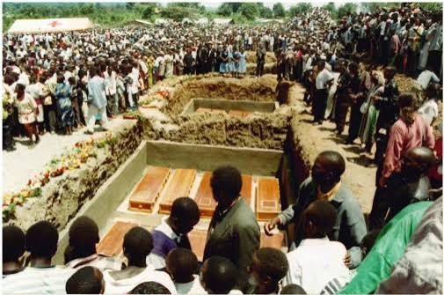
BACKGROUND
June 2026: At least 330 cases of school unrest were reported within less than 2 months with 95 fire incidents, 34 attempted arson attacks and 18 learner deaths. ³
The recurrence and severity of school unrest suggest persistent unaddressed underlying factors.
There is a need for a deeper understanding of the psychosocial, institutional and systemic drivers of unrest to inform effective prevention strategies.
3. Daily Nation [Internet]. June 23, 2026

Slide 4
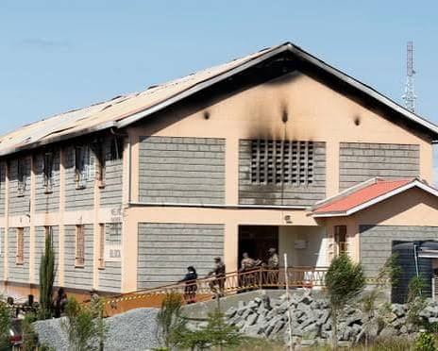
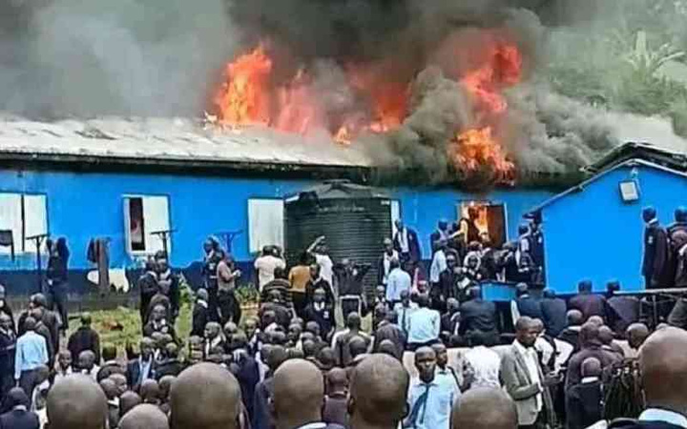
BROAD OBJECTIVE
  To explore the causes of unrests in Kenyan Senior Schools and any associated underlying mental health issues.

Slide 5
SPECIFIC OBJECTIVES
To identify the primary systemic and environmental triggers of repeated unrests in Kenyan senior schools.
To assess the prevalence of psychological distress indicators such as anxiety, depression and substance use among students in Kenyan senior schools.
To determine the accessibility and effectiveness of existing mental health support frameworks such as guidance and counselling services within Kenyan senior schools.

Slide 6
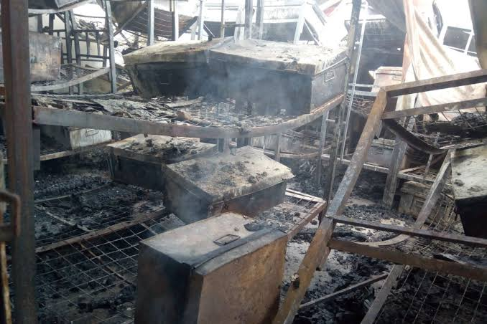
METHODS
Study design
Mixed-methods cross-sectional study
Sampling
Stratified cluster sampling across Cluster 1–4 schools, considering:
  Public & private schools
  Boys & girls
  Schools with and without history of unrest/fire
Data collection
Quantitative: Self-administered questionnaires + psychological screening tools
Qualitative: FGDs and in-depth interviews with students, teachers, parents & school heads

Slide 7
METHODS
Data analysis
Quantitative: Descriptive statistics + multivariable logistic regression
Qualitative: Framework-based thematic analysis
Significance: p < 0.05
Ethical considerations
Ethical approval will be sought from KNH-UoN ERC
Informed consent • Parental consent • Minor assent

Slide 8
EXPECTED OUTCOMES
Identify key drivers of student unrest in Kenyan secondary schools.
Assess mental health and psychosocial factors associated with unrest.
Inform policy and school-level interventions for prevention and early response.
Guide parents, teachers and school administrators in supporting students.
Recommend systemic reforms and support programmes to reduce future unrest.

Slide 9
COI STATEMENT
  The authors declare no competing interests
FUNDING STATEMENT
  This study has not received any funding as of the time of writing this abstract.

Slide 10
ACKNOWLEDGEMENTS
Prof. Muthoni Mathai (Research Supervisor)
Dr. John Gatere
Dr. Frank Njenga

Slide 11
REFERENCES
Ndetei DM, Othieno CJ, Gakinya B, Ndumbu A, Omar A, Kokonya DA, et al. Traumatic grief in Kenyan bereaved parents following the Kyanguli School fire tragedy. World Psychiatry. 2004 Feb;3(1):50–3.
Daily Nation [Internet]. June 30, 2026 [cited 2026 Jul 2]. Utumishi Girls to reopen as principal sent on leave. Available from: https://nation.africa/kenya/counties/nakuru/utumishi-girls-to-reopen-as-principal-sent-on-leave--5513514
Daily Nation [Internet]. June 23, 2026 [cited 2026 Aug 26]. Ministry: 330 cases of school learning disruptions recorded since April. Available from: https://nation.africa/kenya/news/education/ministry-330-cases-of-school-learning-disruptions-recorded-since-april-5505552

Slide 12
THANK YOU!
Comments and Suggestions for Improvement are
Welcome

